Slide 1
KiD-A: How Different Are Aerosol-Cloud-Precipitation Interactions from a Variety of Microphysics Schemes?
Adrian Hill and Zach Lebo
Participants: Ben Shipway, Ryo Onishi, Miroslaw Andrejzuk, Piotr Dziekan, Sylwester Arabas, Dorota Jarecka, Andrew Gettleman, Hugh Morrison, Carolina Juan, Jason Milbrandt, Benoit Vie, Fabien Hoffman
www.metoffice.gov.uk © Crown Copyright 2017, Met Office

Slide 2
Brief history of the GCSS/GASS microphysics project & KiD
Uncertainty due to microphysics in GCSS RICO intercomparison
Using a kinematic flow in participants models discussed @ GCSS Toulouse 2008, but too complicated
1-D Kinematic driver (KiD) model developed at MO, released in early 2010
2010 GCSS microphysics meeting in Seattle we discussed KiD model
Shipway & Hill (2012) published – describes the KiD model
May 2012 – new version of KiD model released, discussed at International Cloud Modelling Workshop (Warsaw)
Hill et al (2015) – presents KiD simulations and precipitation susceptibility (only bulk and 1 bin scheme, again!)
May 2014 – Meeting in Atlanta, decide to start the GASS KiD-A project
submission 1 – April 2015 (presented at the 1st Eulerian vs Langrangian workshop, Warsaw)
bulk, 3 bin schemes
submission 2 (International Cloud modelling workshop, Exeter, June 2016)
bulk, 2 bin schemes and 1 lagrangian scheme
Feb 2018 – 3rd (final??) round of submissions with 1-D and box model submissions from lagrangian, bin and bulk – presented at Pan-GASS and here!
bulk, 3 bin schemes and 3 lagrangian schemes.

Slide 3
Aims of GASS Microphysics Project: KiD-A
Use kinematic case (1-D Cu, 2-D warm clouds) to compare detailed and bulk warm microphysics schemes:
Develop and make available cloud modelling framework for developing and testing future schemes
Sanity check to make sure that the detailed schemes produce similar results, when forced with the same dynamics. If not, understand why
Test how cloud microphysics schemes compare across a range of N_{d,} with and without aerosol processing
Understand if a benchmark for in-cloud aerosol-processing can be established?
Validate bulk schemes against the benchmark
www.metoffice.gov.uk © Crown Copyright 2017, Met Office

Slide 4
Kinematic Driver Model (KiD)
Simple microphysics interface to a common dynamical core
Developed to test a range of microphysics schemes in a consistent dynamic framework
The git repository - https://github.com/Adehill/KiD-A
Includes box testcases, 1-D testcases and 2-D testcases
KiD-A intercomparison includes the following models
Lagrangian models –
Mirek Andrejczuk (Met Office), Fabian Hoffman (NOAA-CIRES), Piotr Dziekan (Warsaw University)
Bin models –
2d-bin (Zach Lebo, University Wyoming), Tel-Aviv University (TAU) scheme (Me, Met Office), MSSG (Ryo Onishi …)
Bulk Schemes –
MG2 (Andrew Gettleman, NCAR), MY2 (Caroline Jouan and Jason Milbrandt, Environment Canada), CASIM (Me, Met Office), LIMA Bulk (Benoit Vie, CNRM)

Slide 5
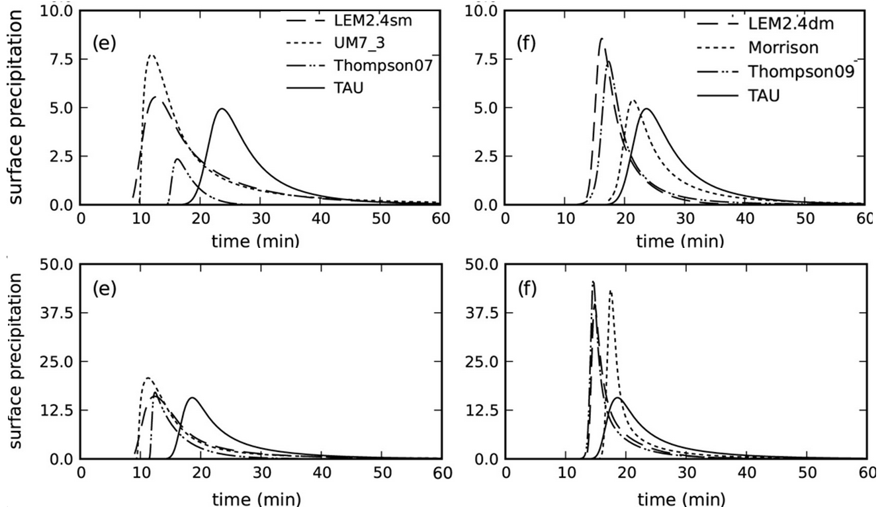
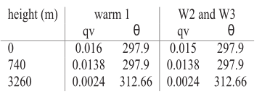
1-D Warm case
Prescribed Vertical velocity:
w₁ sin(π/t₁), if t < t₁
0.0 , if t > t₁
w(z,t) =
t₁ = 600 s and w₁ is max velocity (w_{max}) which is 2 ms⁻¹ in W2 and 3 ms⁻¹ in W3
Initial Profiles: based on RICO case
Based on Shipway and Hill (2012)
1M schemes - precip too early but produce OK max
2M schemes - precip timing better but produce too large max.
Bulk models only compared to one bin model reference
Initial N_{d} or N_{a}
50 cm⁻³, 150 cm⁻³ & 300 cm⁻³

Slide 6
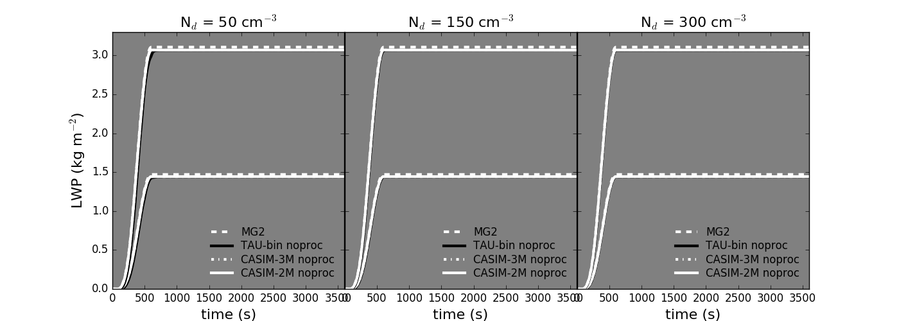
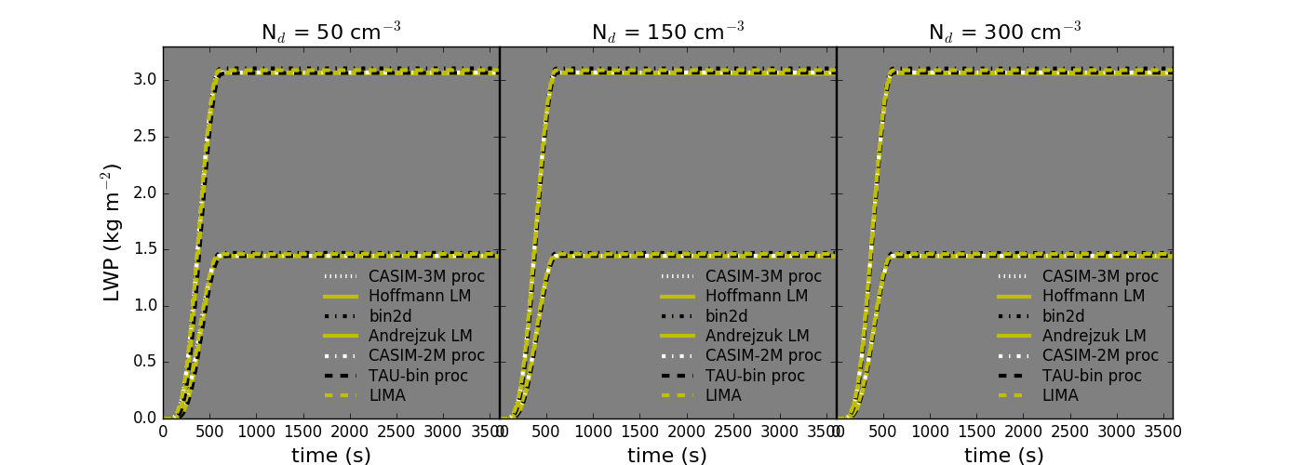
1-D warm with no precipitation/sedimentation
All schemes produce very similar bulk LWP, with only MG2 and bin2d noticeably larger, Good start
However…

Slide 7
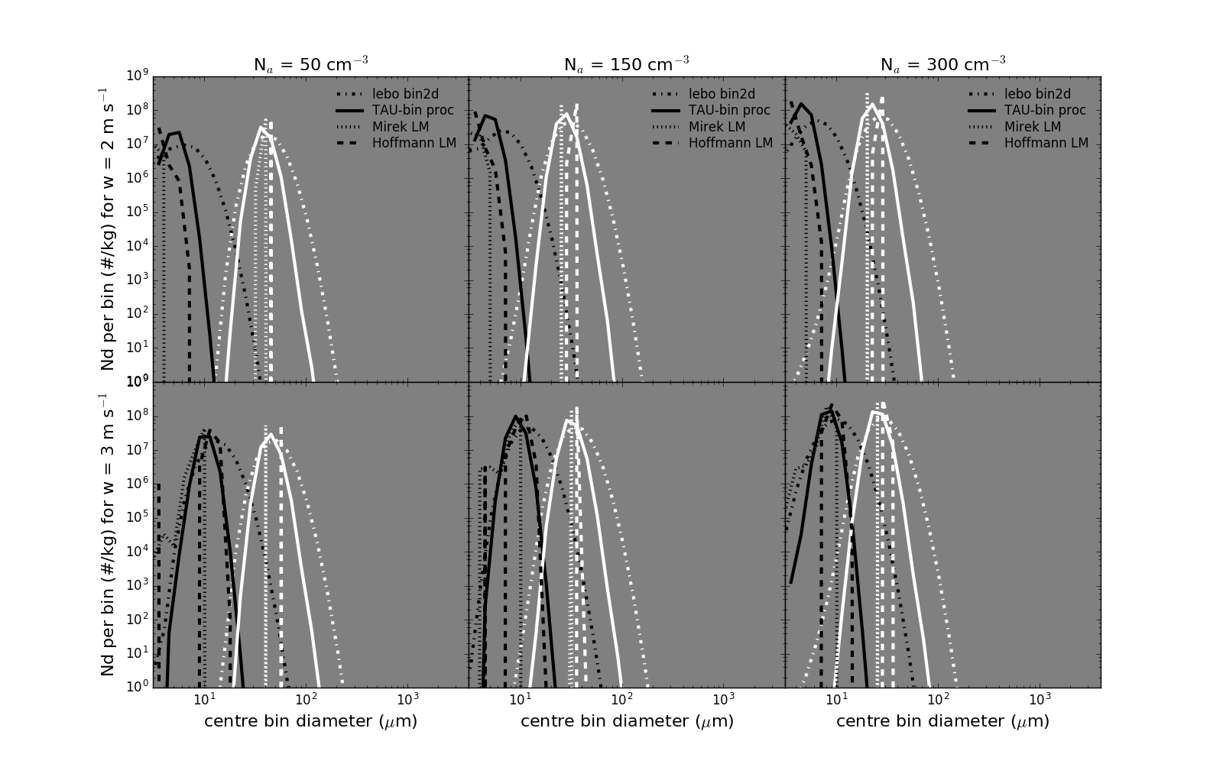
1-D warm with no precipitation/sedimentation
Black = 2 mins, White = 10 mins, all distributions taken from level with max. LWC
Bin schemes produce much broader size dist, with larger particles than the LM scheme.
See Morrison et al, 2018, DOI: 10.1175/JAS-D-18-0055.1, for further discussion

Slide 8
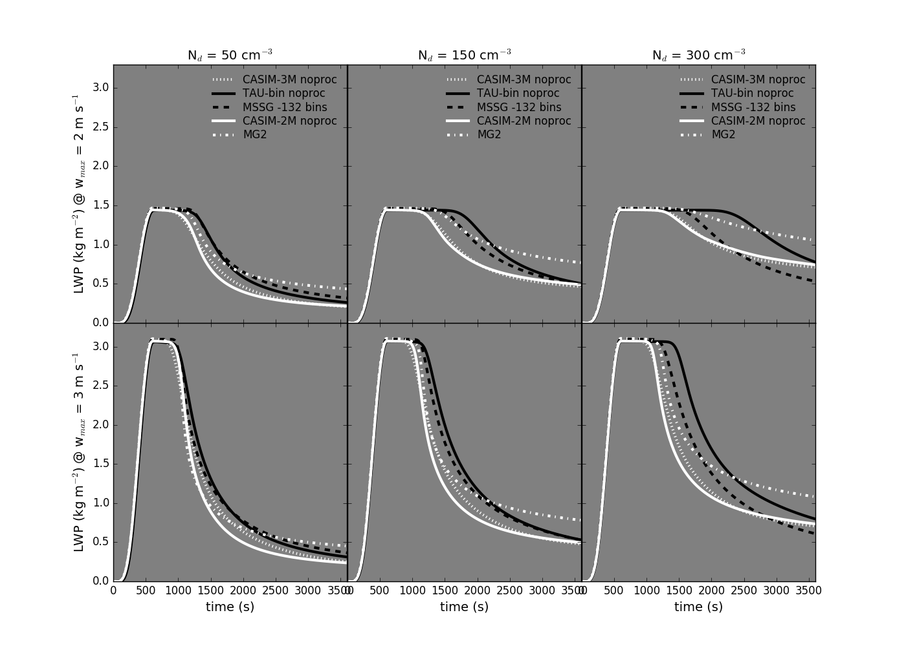
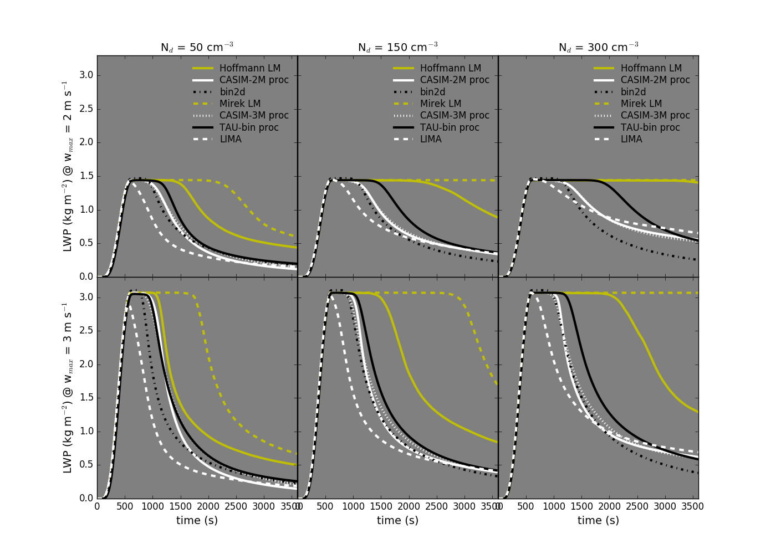
1-D warm with precipitation & sedimentation
No aerosol processing - bin (black) vs bulk (white)
Aerosol processing – lagrangian particle model (yellow) vs bin (black) vs bulk (white)

Slide 9
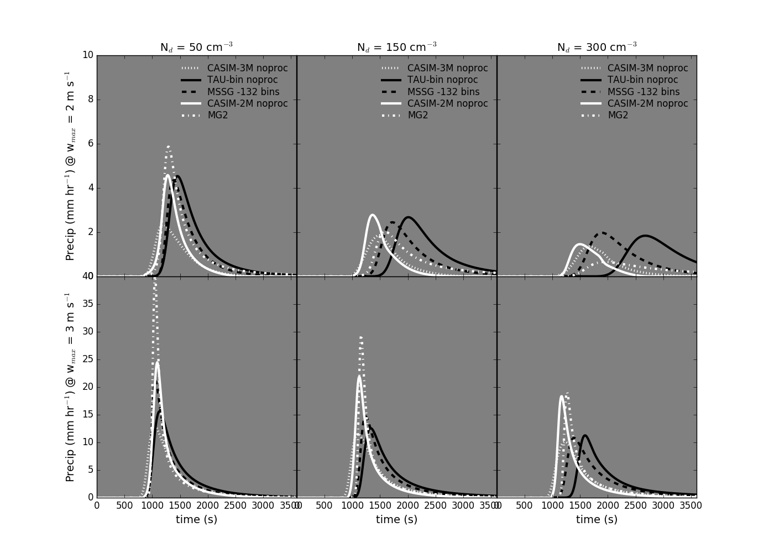
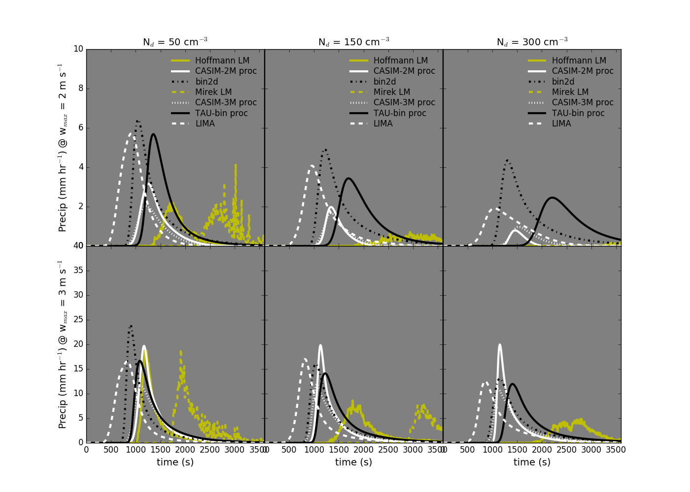
1-D warm with no precipitation/sedimentation
No aerosol processing - bin (black) vs bulk (white)
Aerosol processing – lagrangian particle model (yellow) vs bin (black) vs bulk (white)
Detailed schemes produce the largest spread in LWP and surface precipitation rate and timing – Potential problem for parametrisation development!

Slide 10
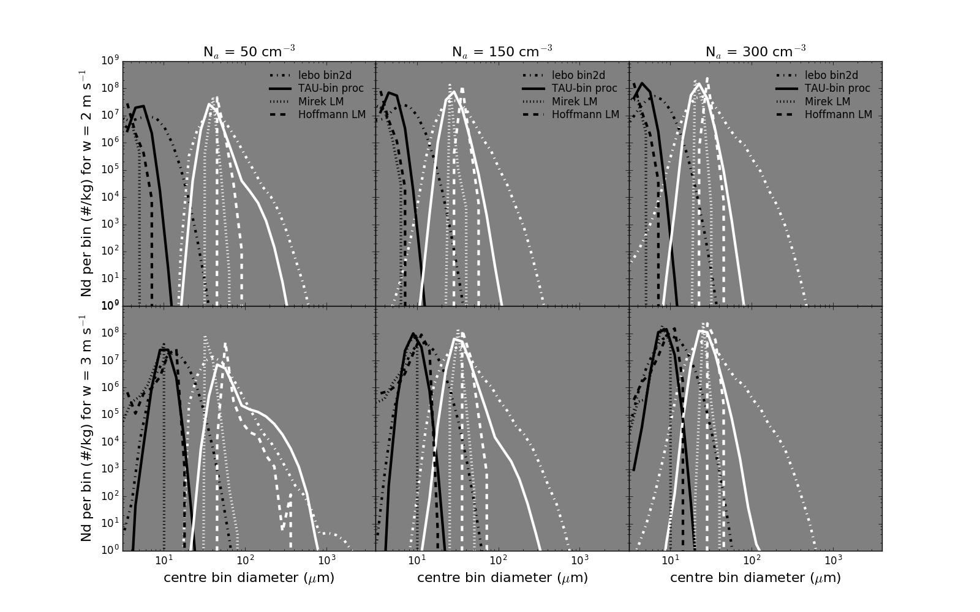
1-D warm with precipitation & sedimentation
Black = 2 mins, White = 10 mins, all distributions taken from level with max. LWC
Bin schemes produce much broader size dist, with larger particles than the LM scheme.
LMs do not agree

Slide 11
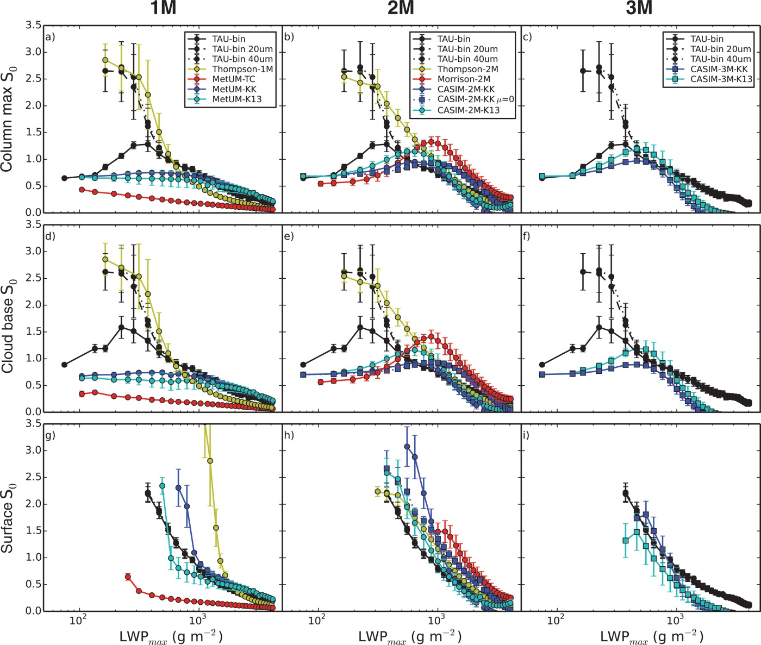
Precipitation and LWP susceptibility
Use precipitation susceptibility (S₀) to compare the sensitivity of schemes to changes in N_{d} or N_{a}
Where R is precipitation rate/amount & N_{d} is a representative cloud drop number concentration. Here we use initial prescribed N_{a} or prescribed N_{d}

Slide 12
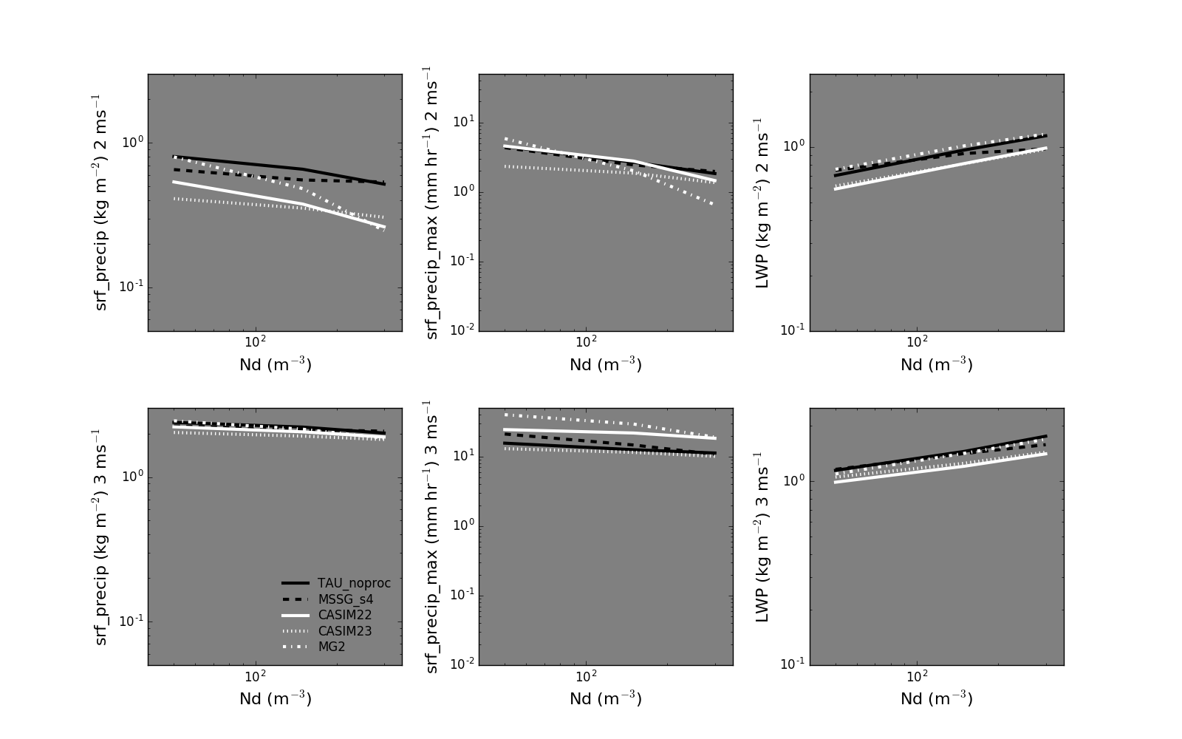
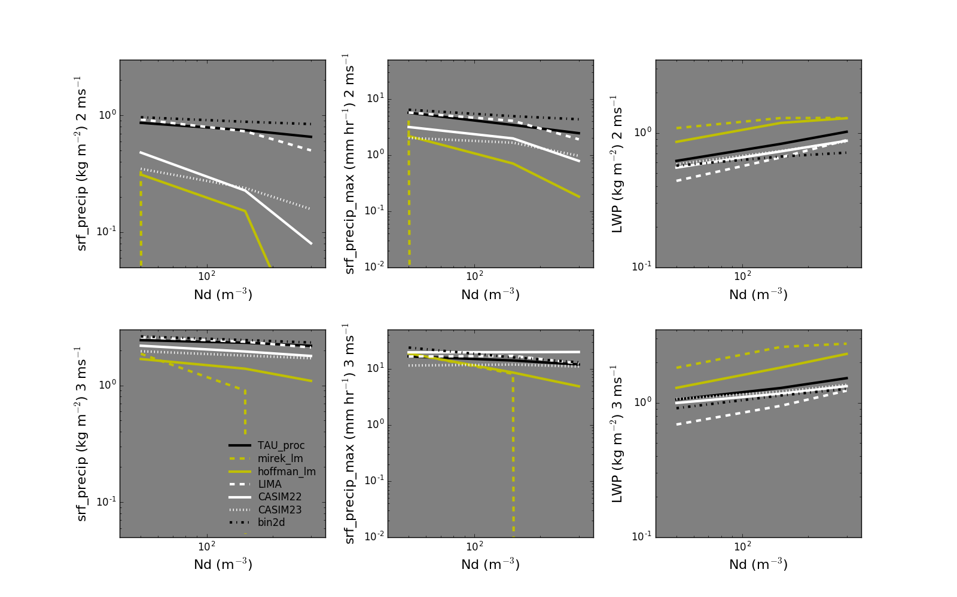
Sensitivity of precipitation and LWP to change in N_{d}
Accumulated surface precip
Maximum surface precip
Mean LWP
Accumulated surface precip
Maximum surface precip
Mean LWP
No aerosol scavenging
Aerosol scavenging

Slide 13
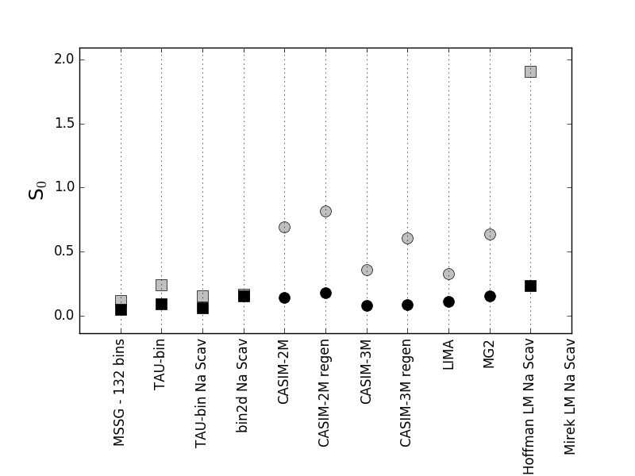
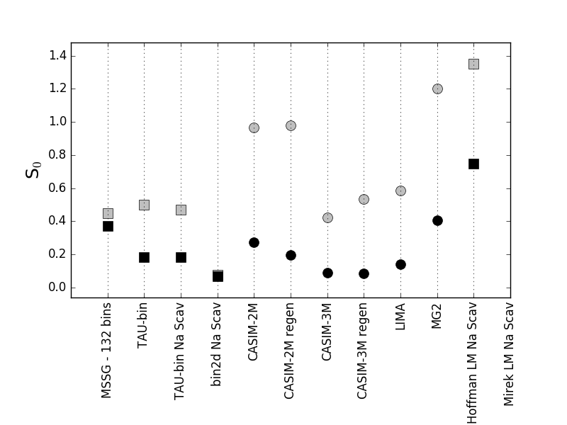
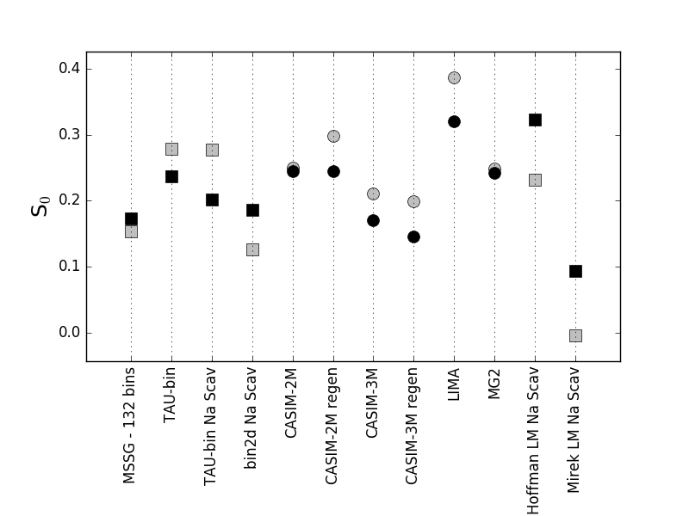
Precipitation and LWP susceptibility
S₀ for mean precip
S₀ for max precip
dlnLWP/dlnN_{d} for mean LWP
Bin
Bulk
LM
Bin
Bulk
LM
Bin
Bulk
LM

Slide 14
What has been achieved
We have developed a framework that is publicly available for users
Test new developments
Run alongside GASS and/or ICMW projects when there are concerns about the influence of microphysics on results
For first time the most detailed models have been compared, i.e. more than one Lagrangian, bin and bulk
We have shown
Bin schemes are in better agreement with each other than bulk schemes
In this framework, the lagrangian schemes produce the least agreement with each other and other schemes.
When considering aerosol-cloud interactions, results suggest that prediction of precipitation rates in detailed schemes diverge at higher number concentrations BUT the bin schemes show good S0 agreement
All detailed schemes exhibit very different size distribution evolution

Slide 15
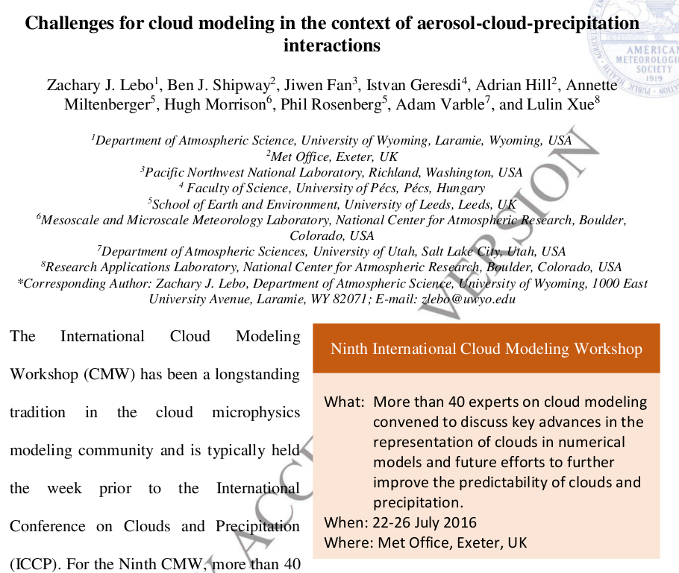
How does KiD-A relate to other work/Final thoughts…(for discussion?)
“The large spread in current “detailed” schemes is problematic and presents a challenge for those hoping to constrain simple numerical approaches or define a benchmark.”
https://doi.org/10.1175/BAMS-D-16-0291.1

Slide 16
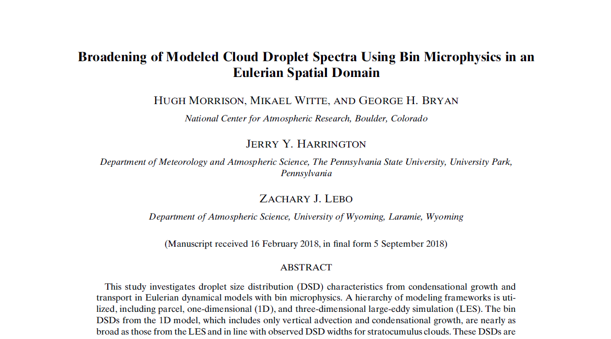
How does KiD-A relate to other work/Final thoughts…(for discussion?)
Compares bin model (BM) with lagrangian (LCM) and demonstrates unphysical spectral broadening when only condensation is considered. Questions whether BMs can be used to investigate the “physical mechanisms for DSD broadening”
JAS - DOI: 10.1175/JAS-D-18-0055.1

Slide 17
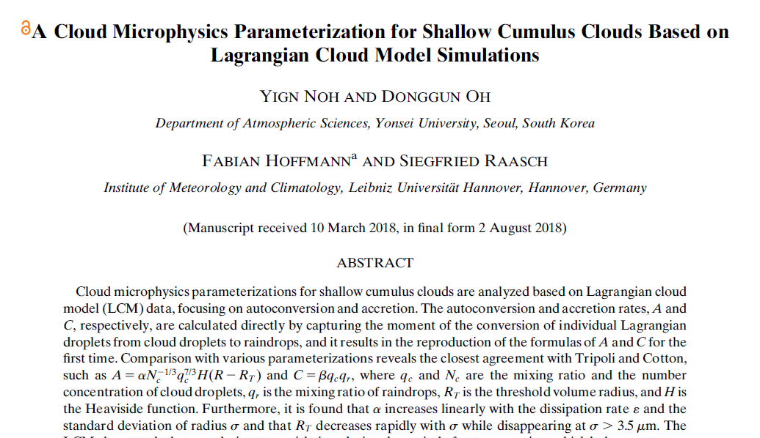
How does KiD-A relate to other work/Final thoughts…(for discussion?)
Uses LCM to test and derive autoconversion and accretion parametrisation, DOI: 10.1175/JAS-D-18-0080.1
Are LCMs ready for such application?

Slide 18
Where to go from here?
Try and persuade another lagrangian model to join and maybe other bin schemes?
Analyse the 0-D box models tests
Understand the variation in size distribution between schemes
Finally write up!

Slide 19
Thanks for listening
Any questions?

Slide 20
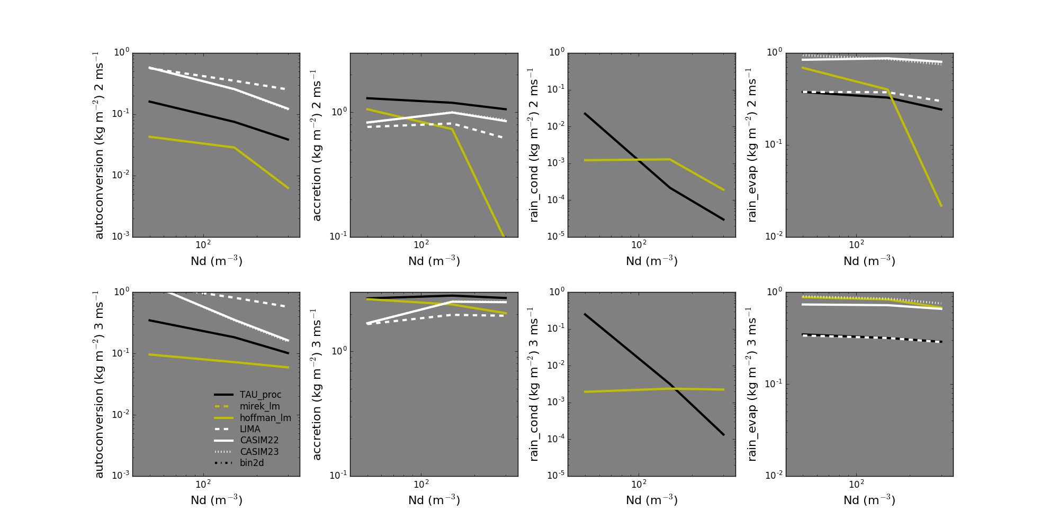
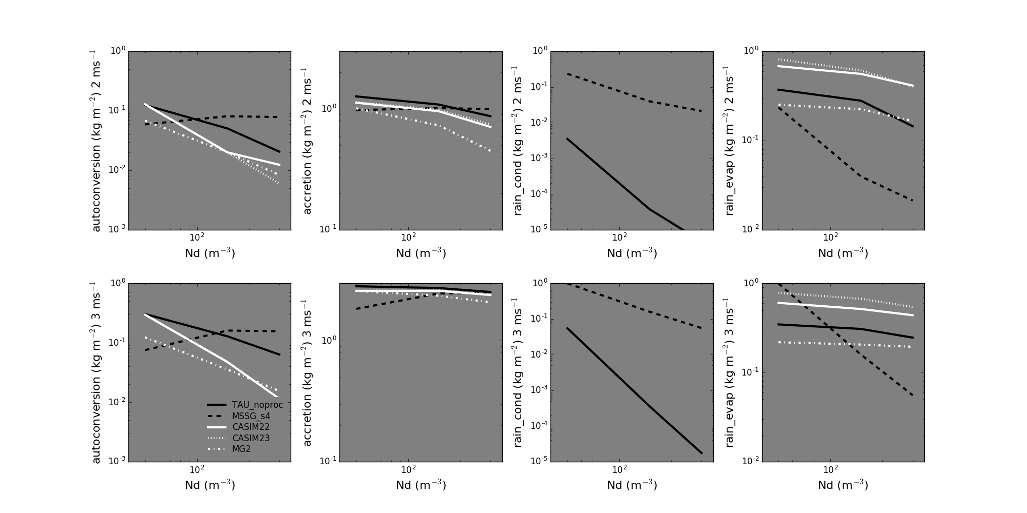

Slide 21
Box model tests
Two box model test cases in KiD with no flow, sedimentation or activation
Collision-Coalescence
Assume: initial q_{c}, μ, N
q_{c} = 1.0 g kg^{-1,} N = 50, 150, 300 cm⁻³
μ = 0, 2
Distributed using gamma distribution
Processes: only collision-coalescence
Simulation: 1 hr
Condensation
Assume: initial q_{c}, μ, N
q_{c} = 0.1 g kg^{-1,} N = 50, 150, 300 cm⁻³
μ = 0, 2
Distributed using gamma distribution
Processes: only condensation/evaporation with fixed supersaturation (0.1%)
Simulation: 10 min

Slide 22
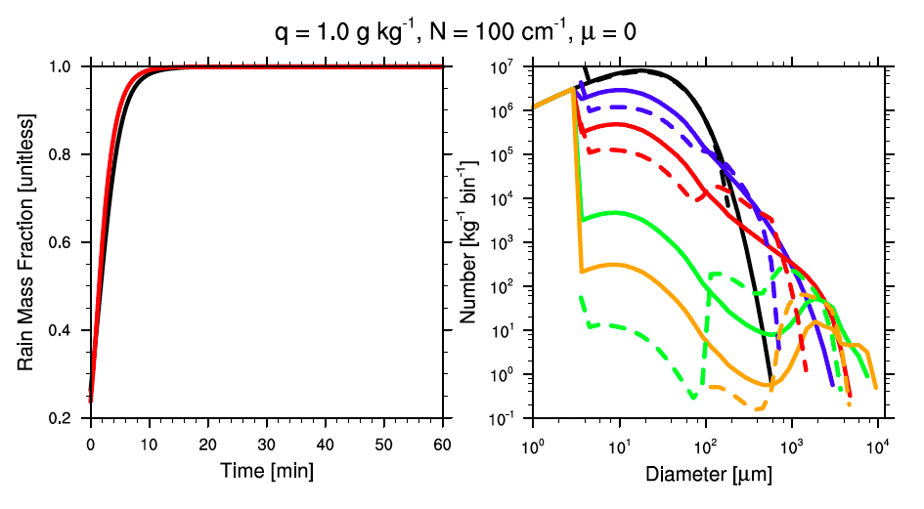
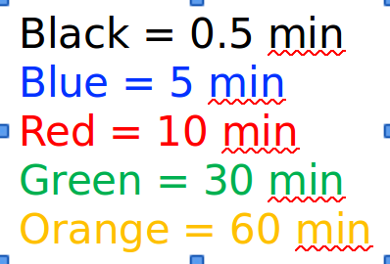
Collision-coalescence box test
Condensation box test
Black = 0.5 min
Blue = 5 min
Red = 10 min
Green = 30 min
Orange = 60 min
Black = 0.5 min
Blue = 5 min
Red = 10 min
Green = 30 min
Orange = 60 min
Black = 0.5 min
Blue = 5 min
Red = 10 min
Green = 30 min
Orange = 60 min
Black = 0.5 min
Blue = 5 min
Red = 10 min
Green = 30 min
Orange = 60 min

