Slide 2
PyACPIM - python Aerosol Cloud Precipitation Interactions Model
Open Access
Available to download from www.eurochamp.org and github
Graphical user interface
Model is run through a GUI
Based on the ACPIM model
(Connolly et al 2012, …)
EUROCHAMP-2020
Designed as a tool to plan and interpret experiments carried out in cloud chambers

Slide 3
Infrastructure of atmospheric simulation chambers across Europe
Aerosol chambers
Cloud chambers
Database of chamber experiment results
Atmospheric chemistry
Clouds
Models for interpreting results - pyACPIM and pyCHEM

Slide 4
History of ACPIM model
Frey et al 2018 - Ammonium sulphate experiments MICC
Simpson et al 2018 – INP and CCN mixture in MICC + adiabatic parcel simulations
Emersic et al 2015 – Ice nucleation in MICC
Skrotzki et al 2013 – Cirrus experiments in AIDA chamber
Connolly et al 2012 – Ice aggregation efficiency in MICC

Slide 5
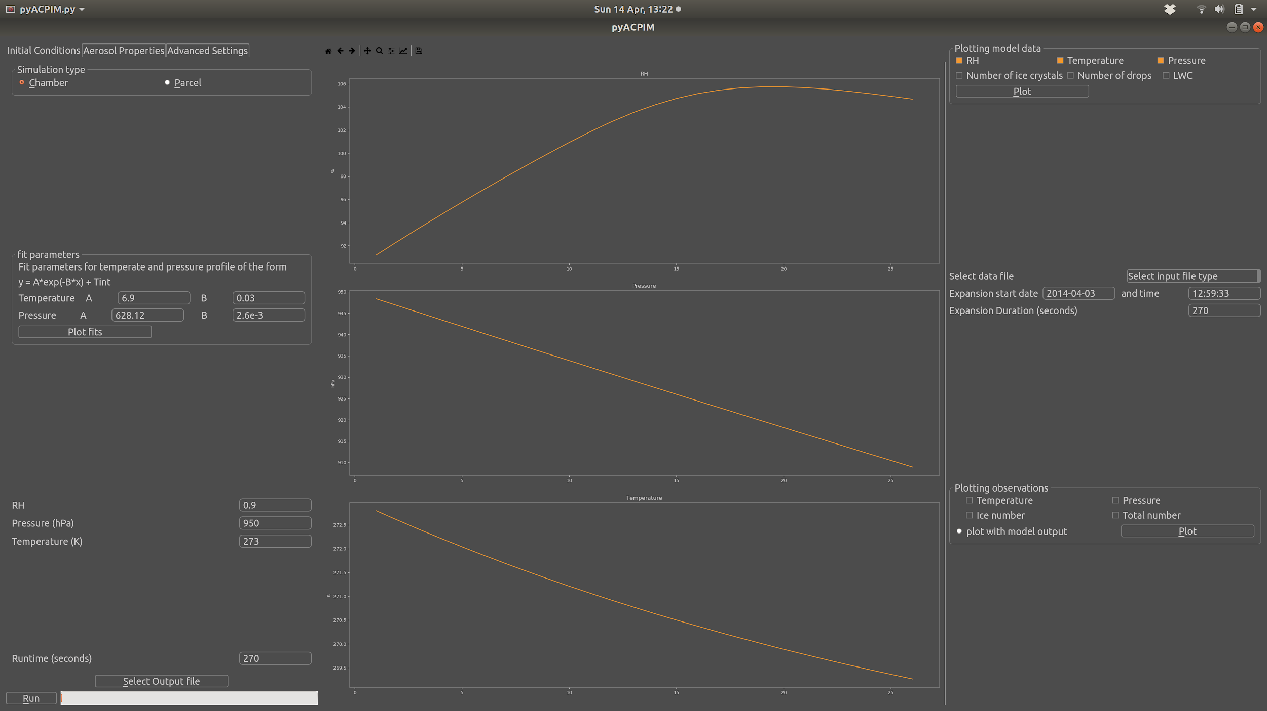
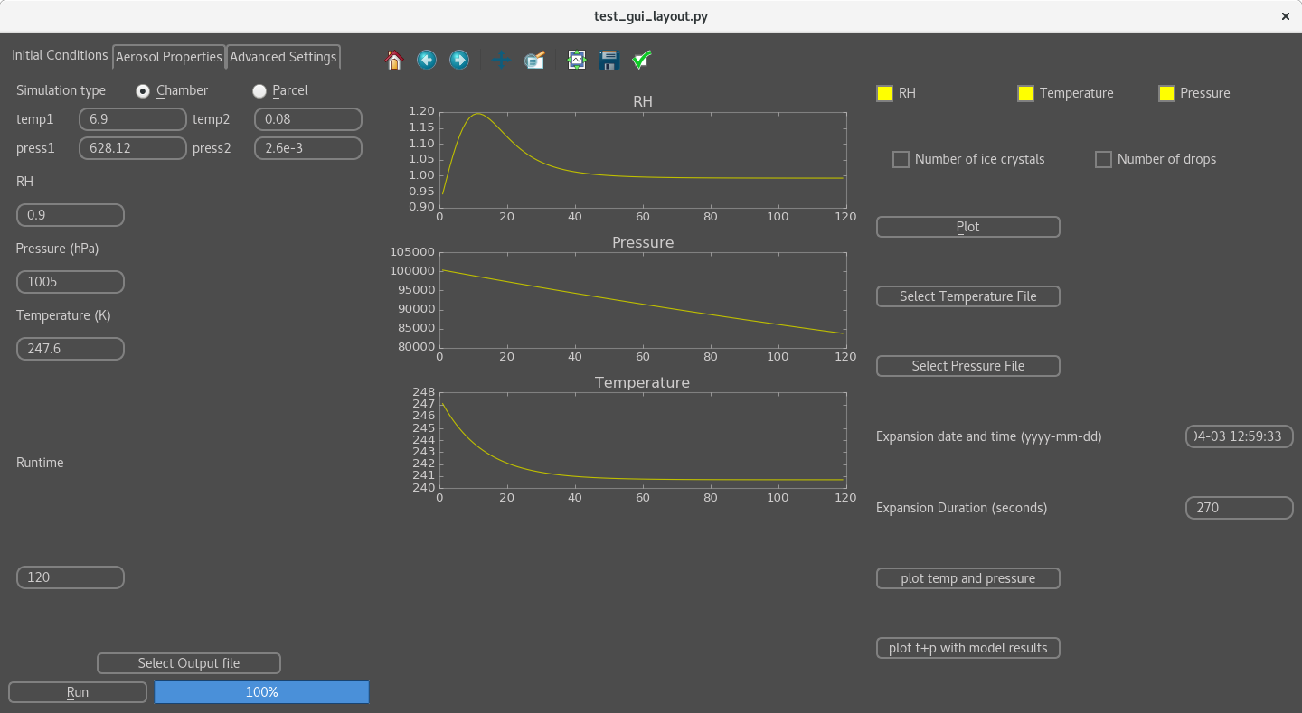
Notes:
Generate aerosol in MAC, control number by diluting with clean air
Slightly depressurize MICC
Open valves connecting the two chambers, the contents of MAC is pulled through into MICC by pressure difference
Measure aerosol size distribution in MICC
Cloud expansion
Generate aerosol in MAC, control number by diluting with clean air
Slightly depressurize MICC
Open valves connecting the two chambers, the contents of MAC is pulled through into MICC by pressure difference
Measure aerosol size distribution in MICC
Cloud expansion

Slide 6
pyACPIM as a tool to aid cloud chamber experiments
Develop hypothesis
Plan chamber experiments
Chamber experiments
Interpret observations

Slide 7
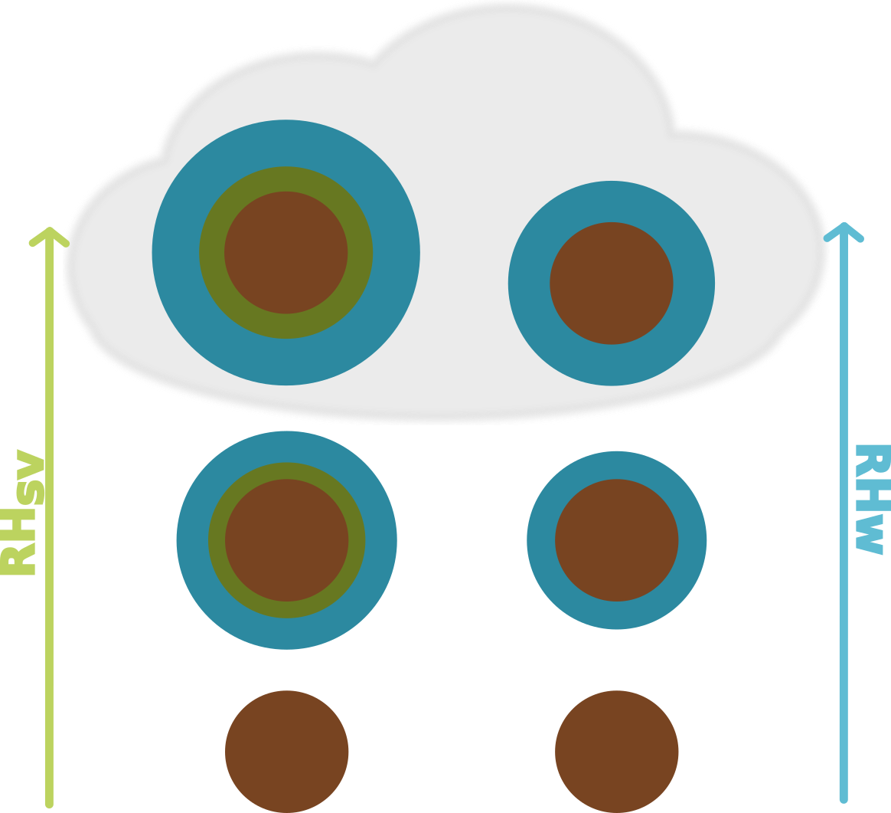
Co-condensation of organic vapour leads to an enhancement of cloud droplet number concentration
Topping and McFiggans 2012 (ACP), Topping et al 2013 (Nat. GeoSci.)
Develop hypothesis

Slide 8
Plan chamber experiments
Chamber experiments

Slide 9
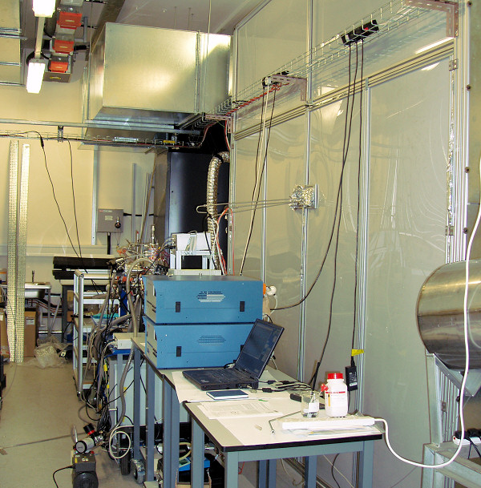
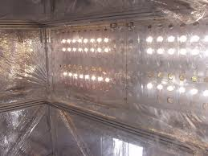
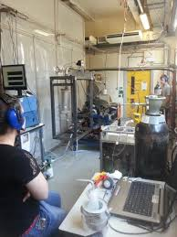
Manchester Aerosol Chamber
18 m3 teflon bag
Collapsible frame
Halogen bulbs and a filtered xenon arc lamp , designed to simulate the solar spectrum
Connected to cloud chamber
Notes:
Maybe change to be more like how i use the chamber to disperse aerosol and control number before sending through to MICC?

Slide 10
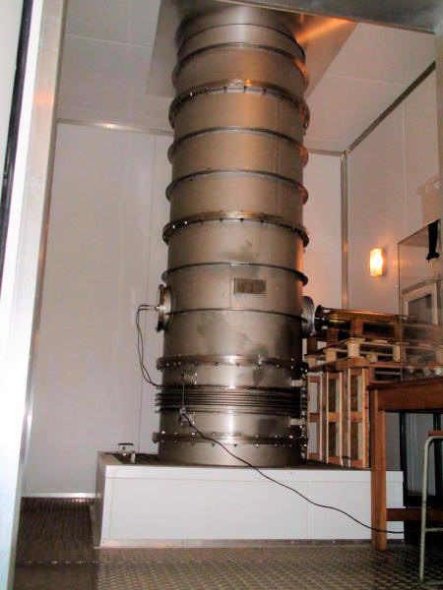
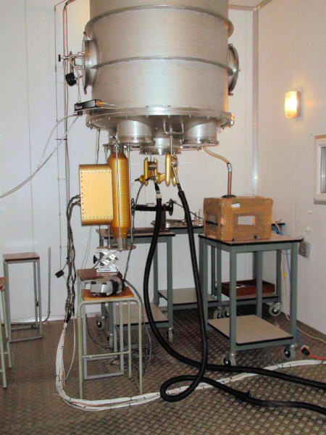
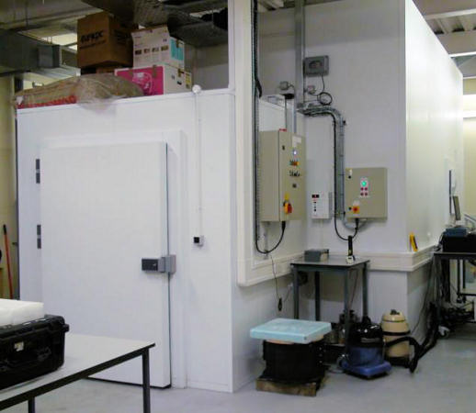
Manchester Ice Cloud Chamber
10 m tall
1 m diameter
8 thermocouples along entire length
Cloud probes sample from the bottom
eg, CDP, FSSP, CPI, WELAS
Housed in 3 freezers
Min T = -50C
Notes:
Need to add MICC-MAC transfer pipe and how the chamber actuals achieves cloud conditions etc …

Slide 11
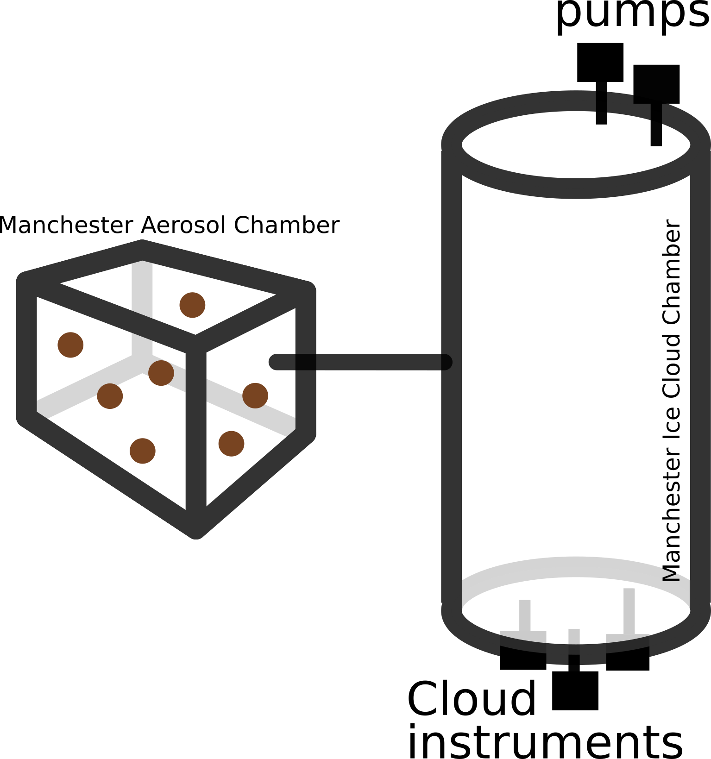
MAC-MICC experimental procedure
Notes:
Generate aerosol in MAC, control number by diluting with clean air
Slightly depressurize MICC
Open valves connecting the two chambers, the contents of MAC is pulled through into MICC by pressure difference
Measure aerosol size distribution in MICC
Cloud expansion
Generate aerosol in MAC, control number by diluting with clean air
Slightly depressurize MICC
Open valves connecting the two chambers, the contents of MAC is pulled through into MICC by pressure difference
Measure aerosol size distribution in MICC
Cloud expansion

Slide 12
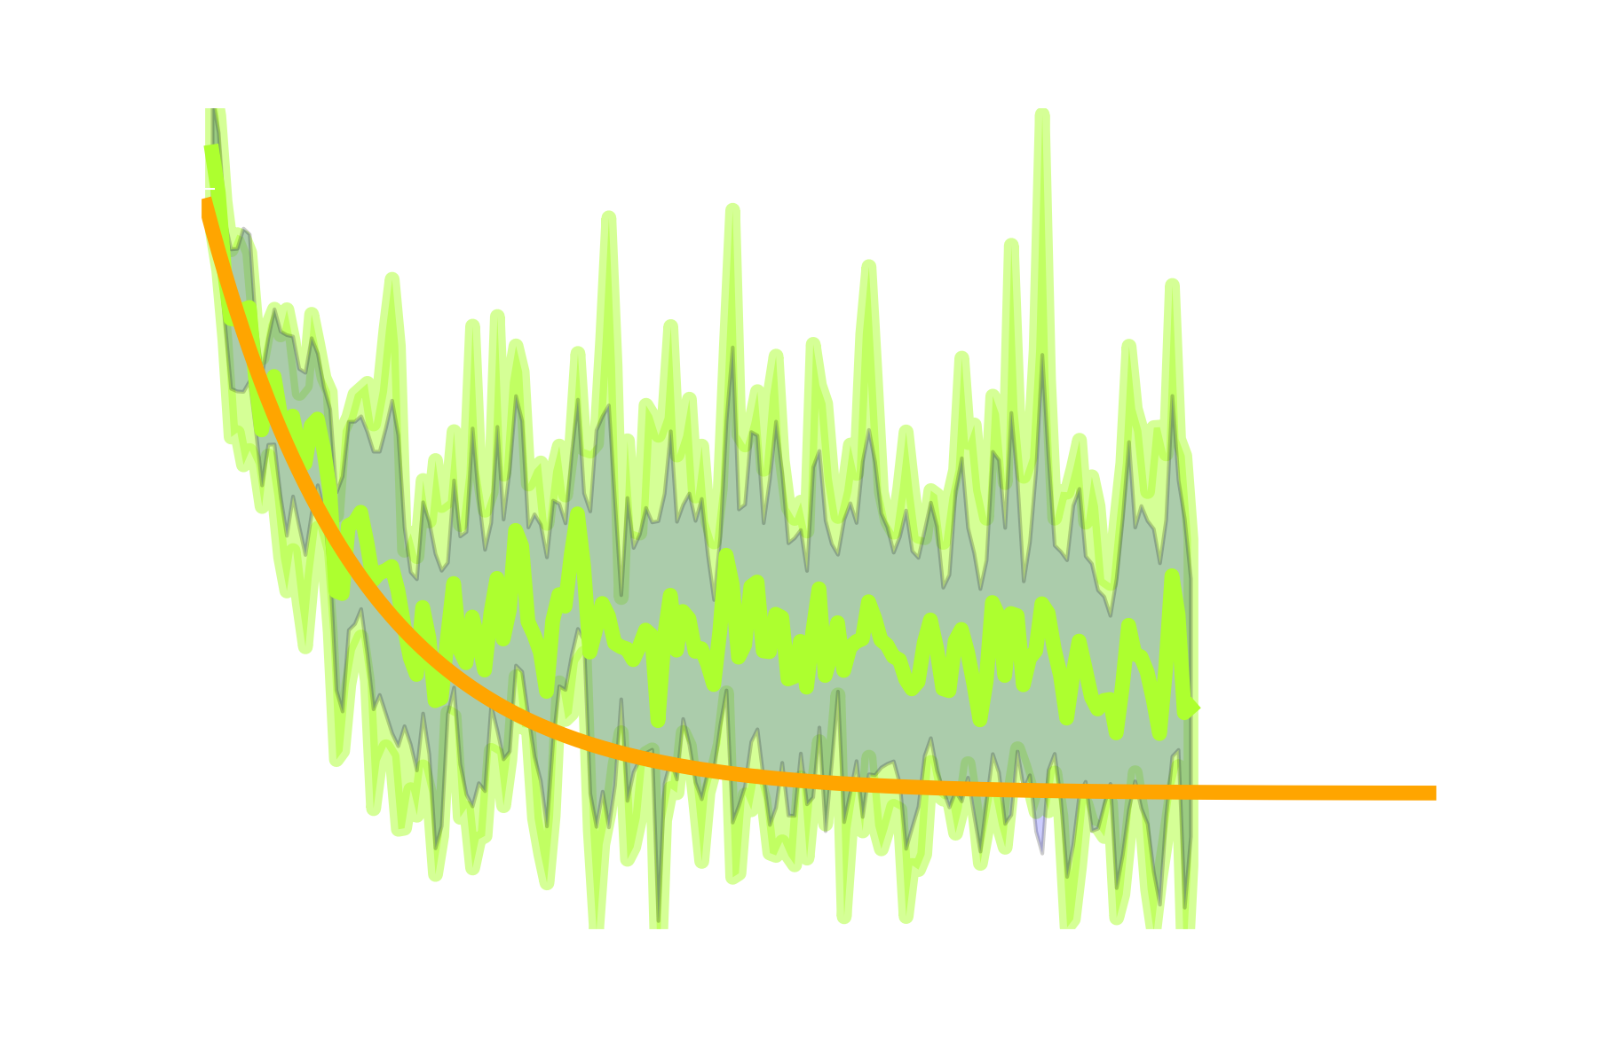

Slide 13
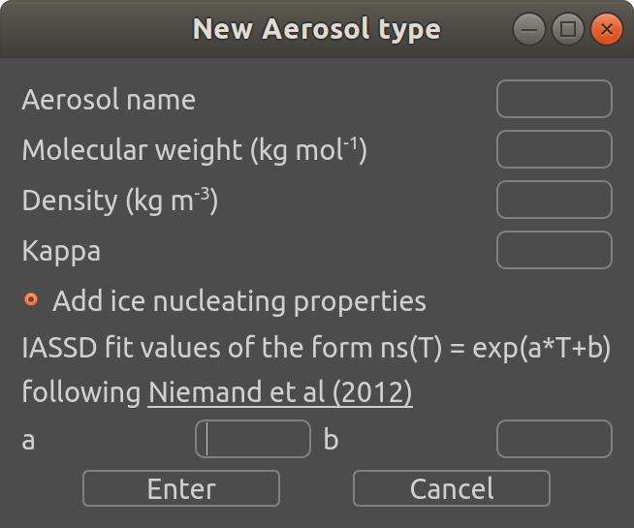
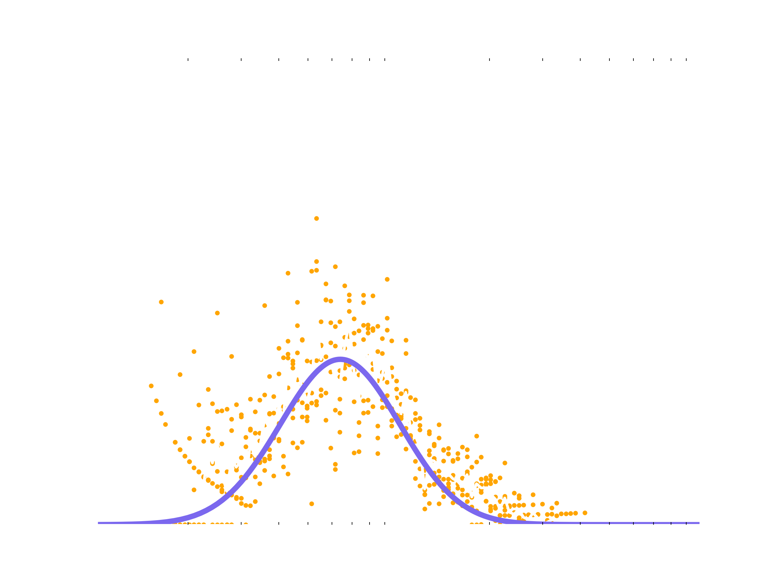
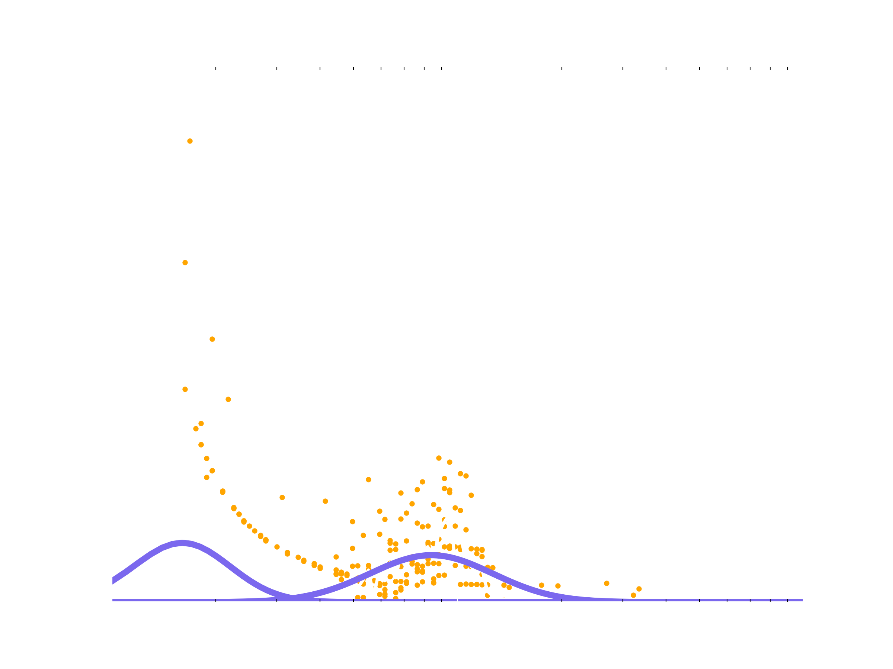
Lognormal fit to observations
Notes:
Aerosol can be of any composition, internal or externally mixed.
Solid or semi-volatile

Slide 14
Growth of Aerosol
Binned microphysics
Each mode represented by a number of bins (~70)
Fully moving bin structure
Water vapour condensation
Kappa-kohler theory
Semi-volatile condensation
Kohler theory
Initial vapour mixing ratio calculated using Crooks et al 2016 Partitioning theory assuming equilibrium
Ice nucleation
Ns parameterisation
Notes:
Aerosol can be of any composition, internal or externally mixed.
Solid or semi-volatile

Slide 15
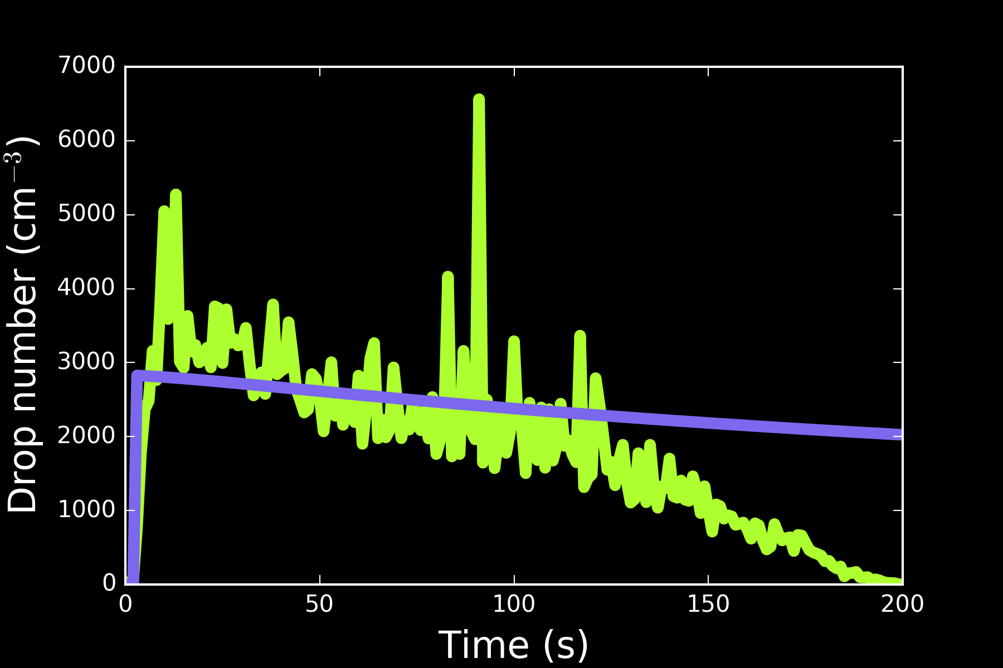
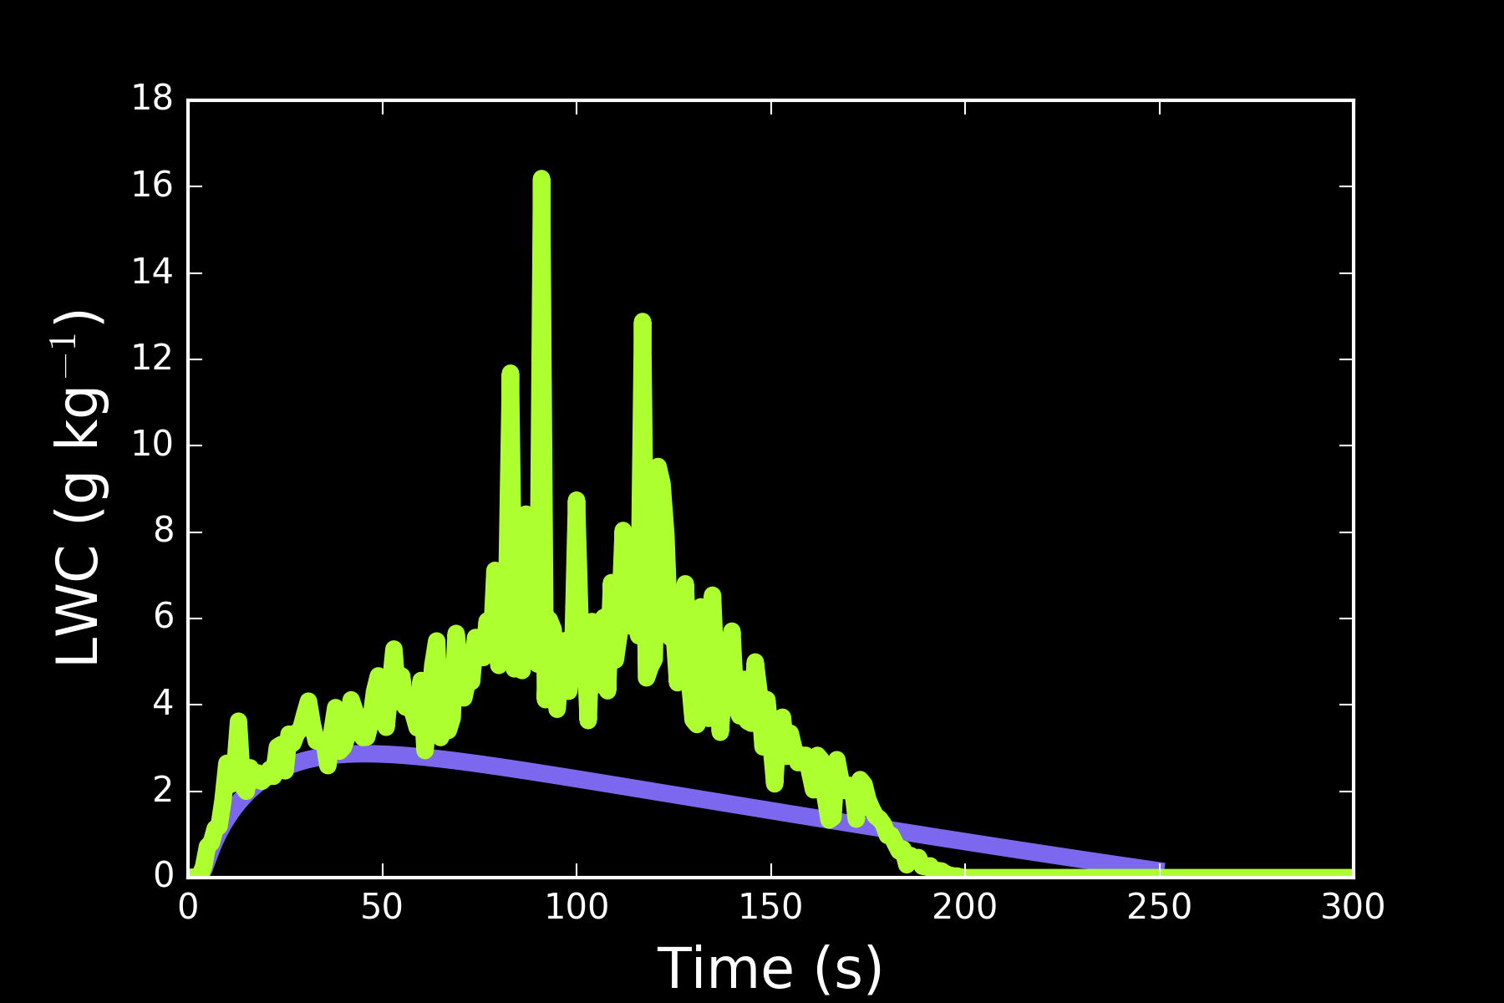
Chamber results - Ammonium sulphate

Slide 16
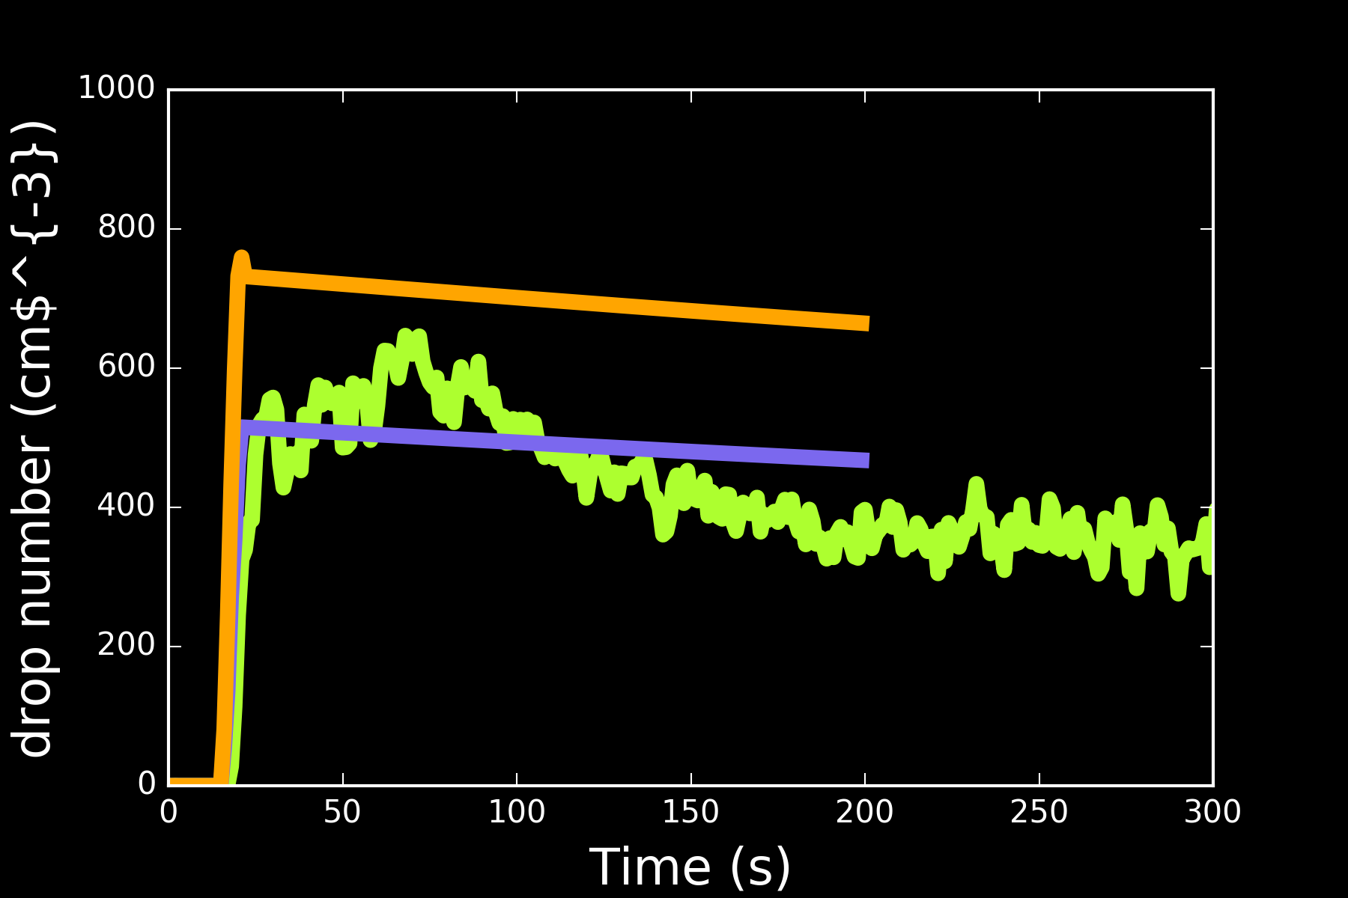
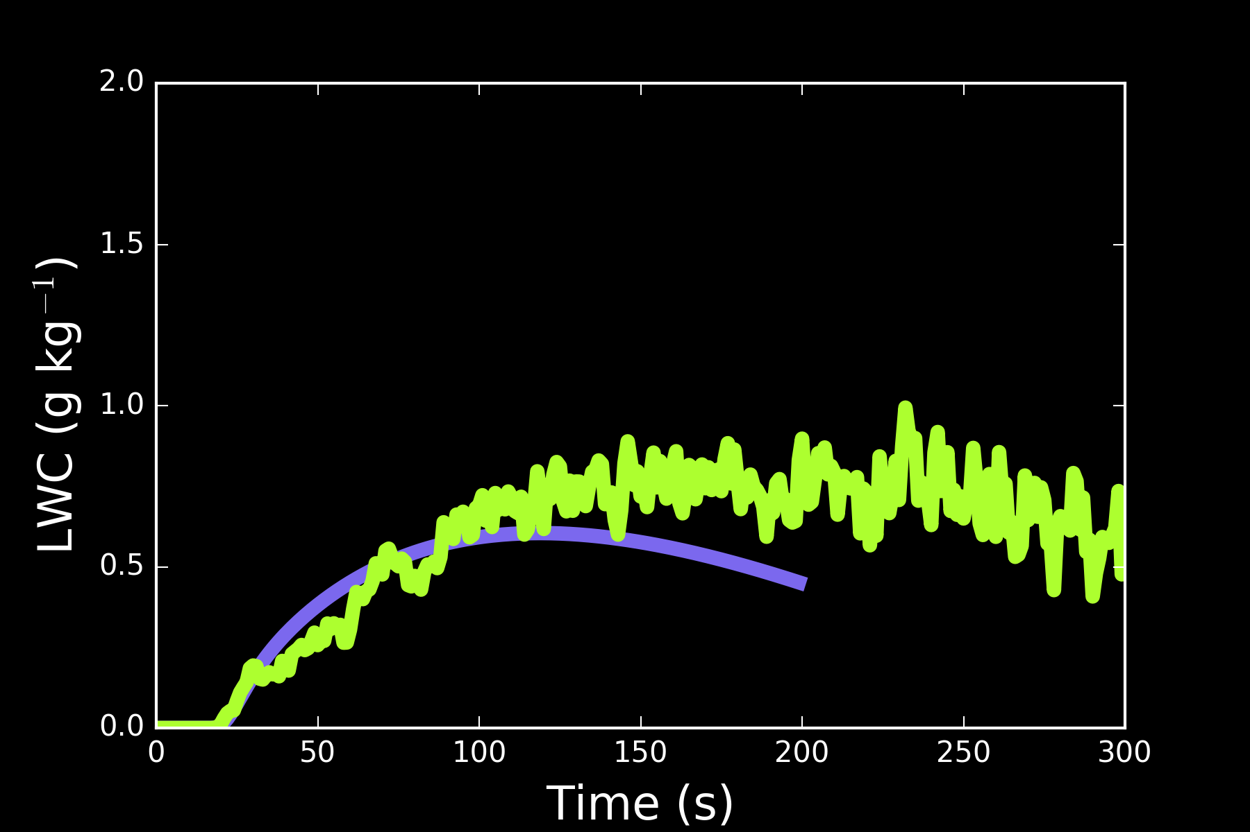
Chamber results - Pimelic acid (semi-volatile)

Slide 17
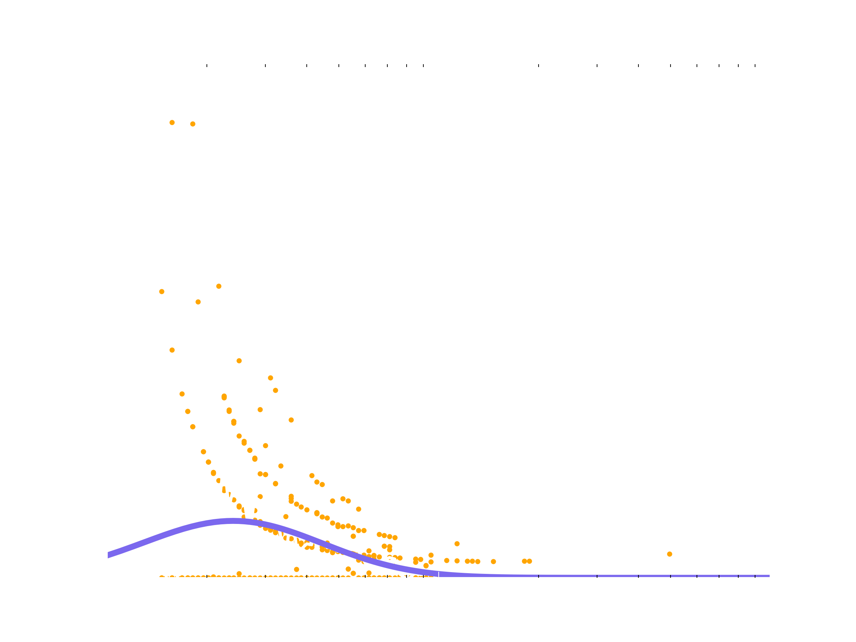
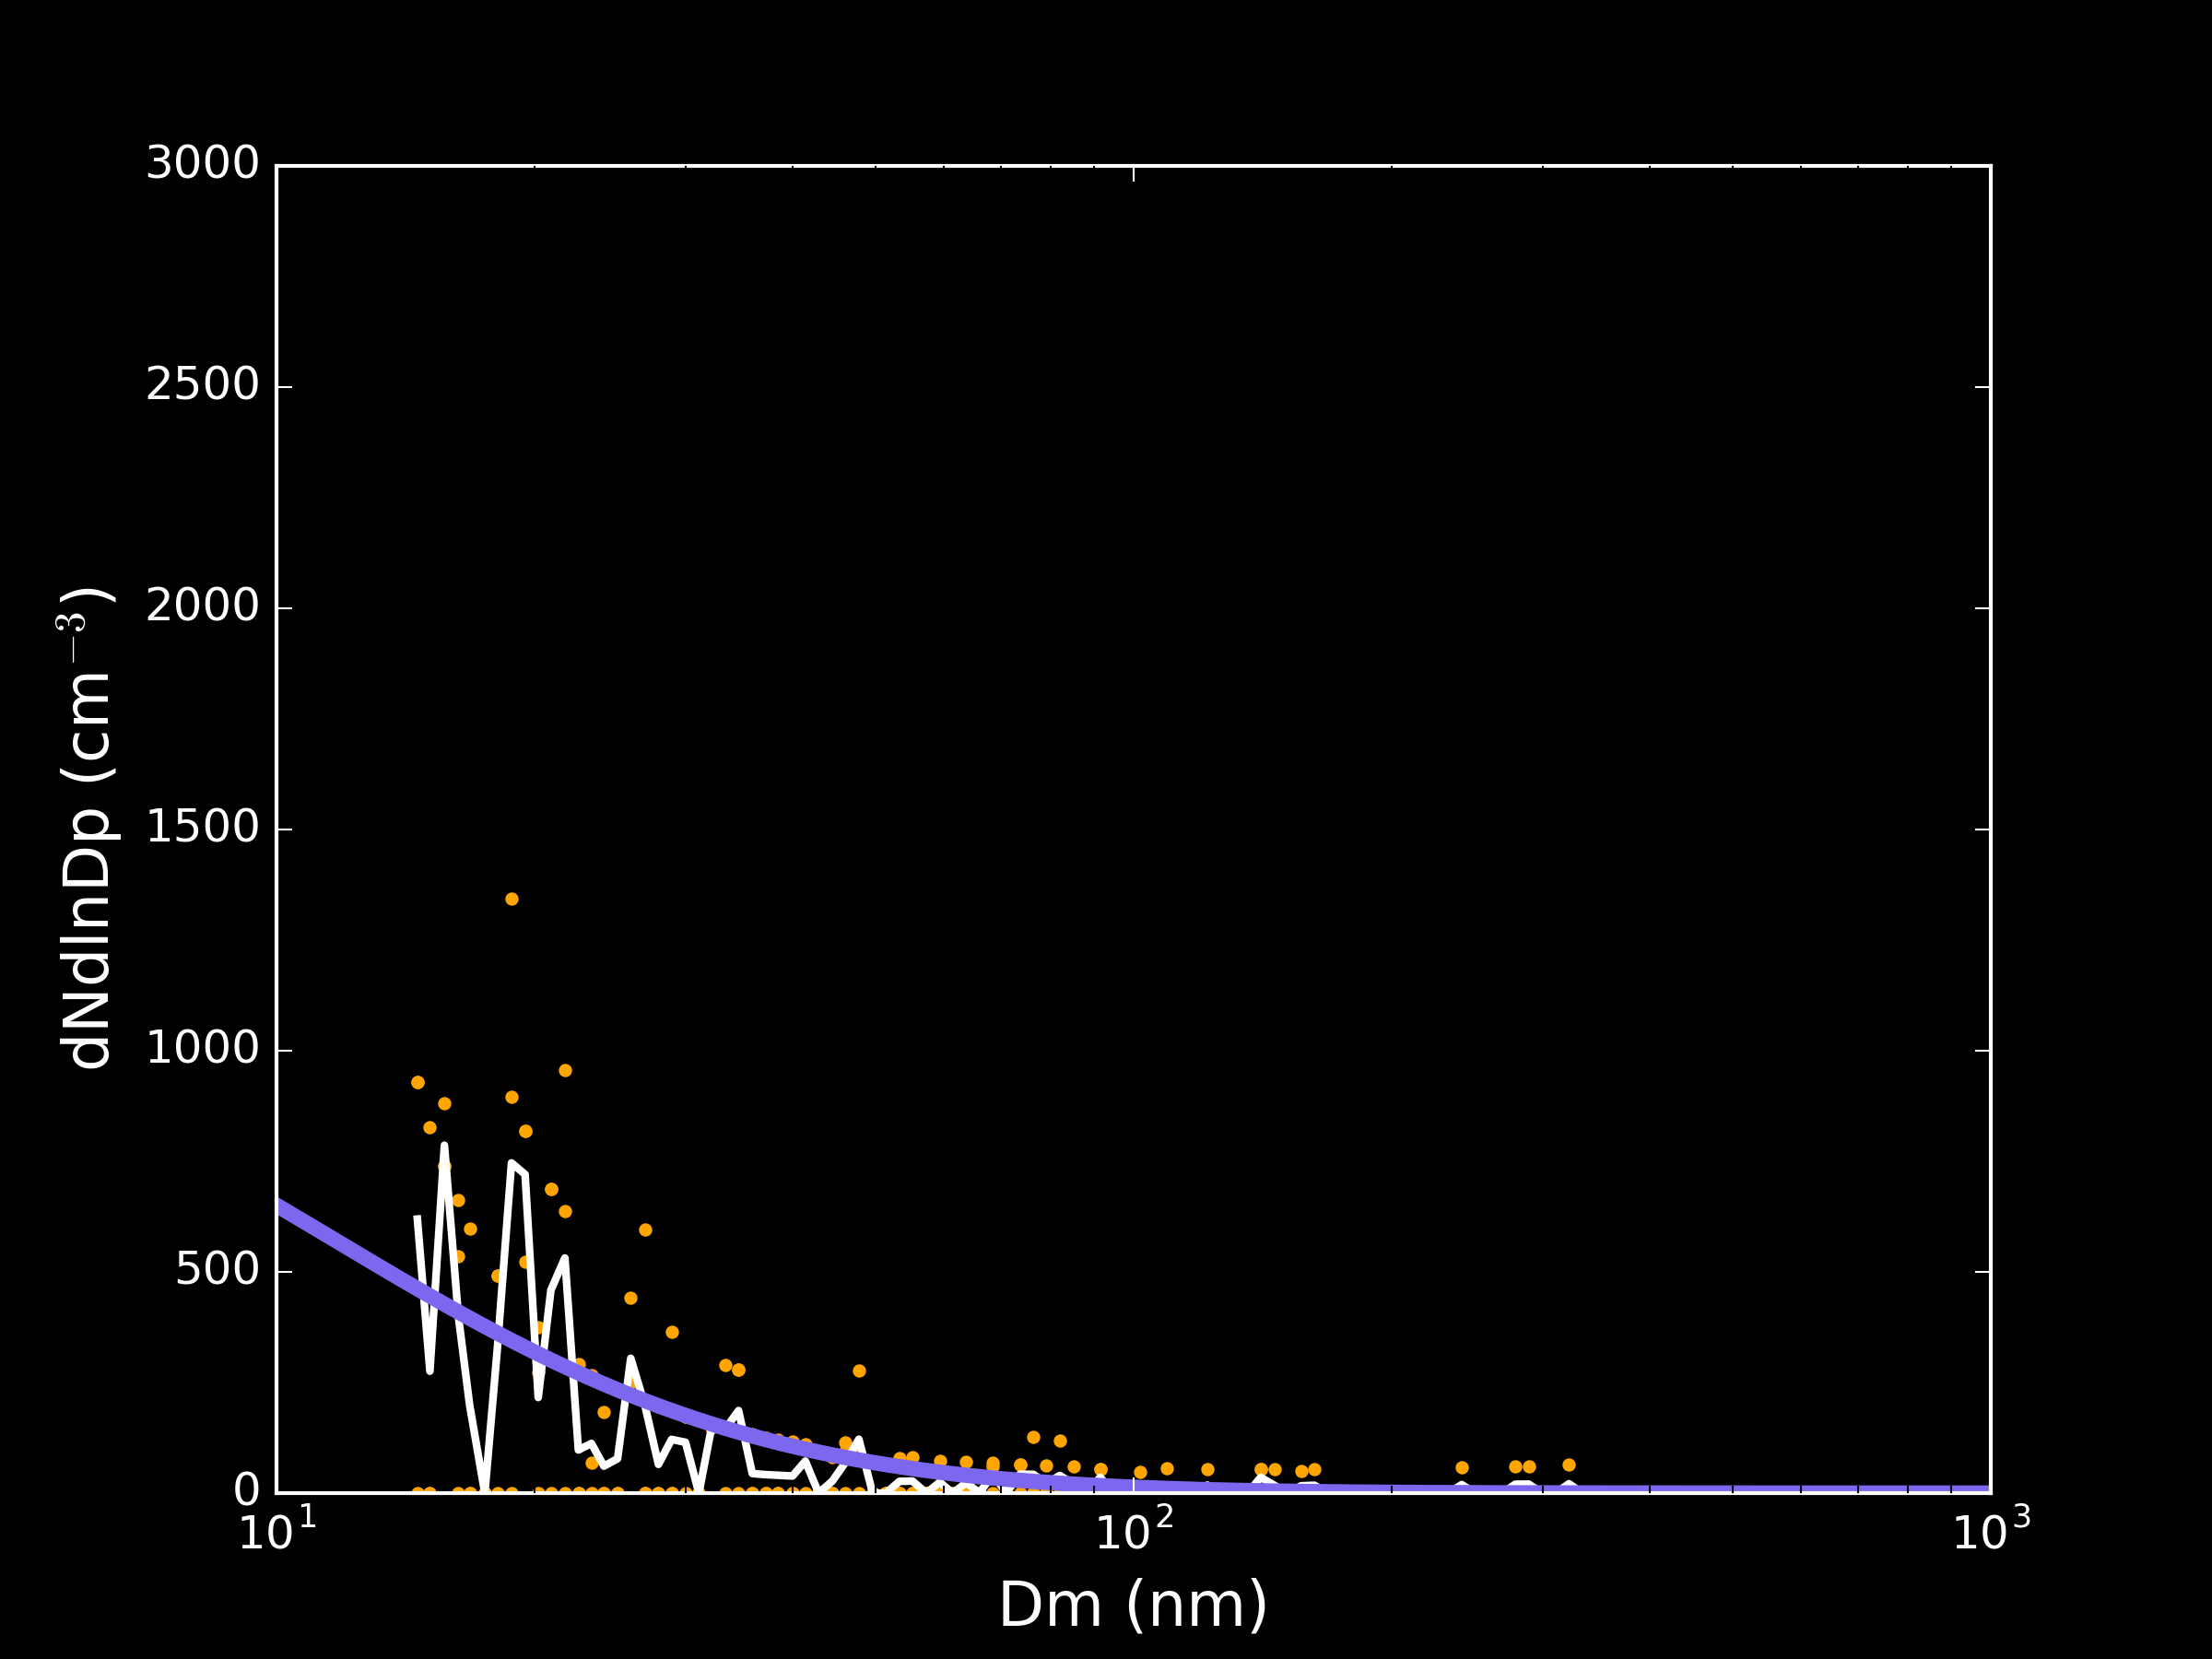
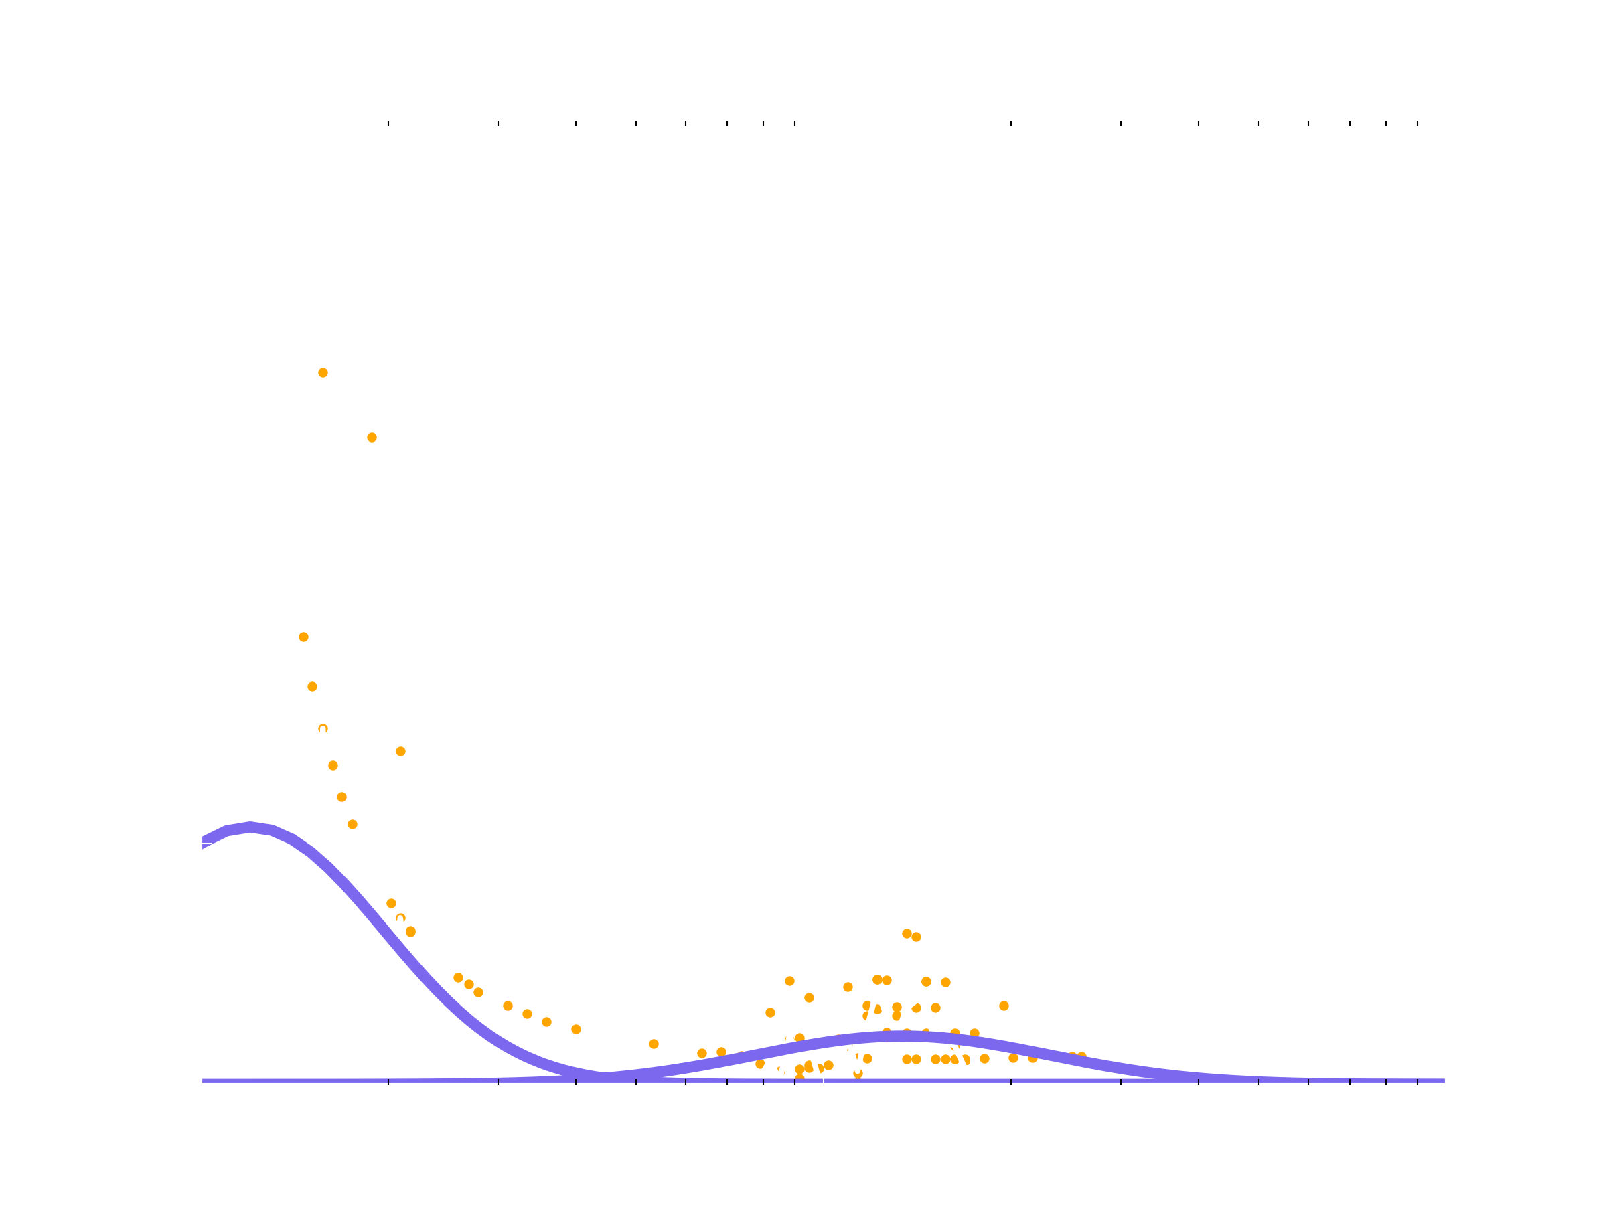
Assuming equilibrium for more volatile compounds
Before cloud
After cloud

Slide 18
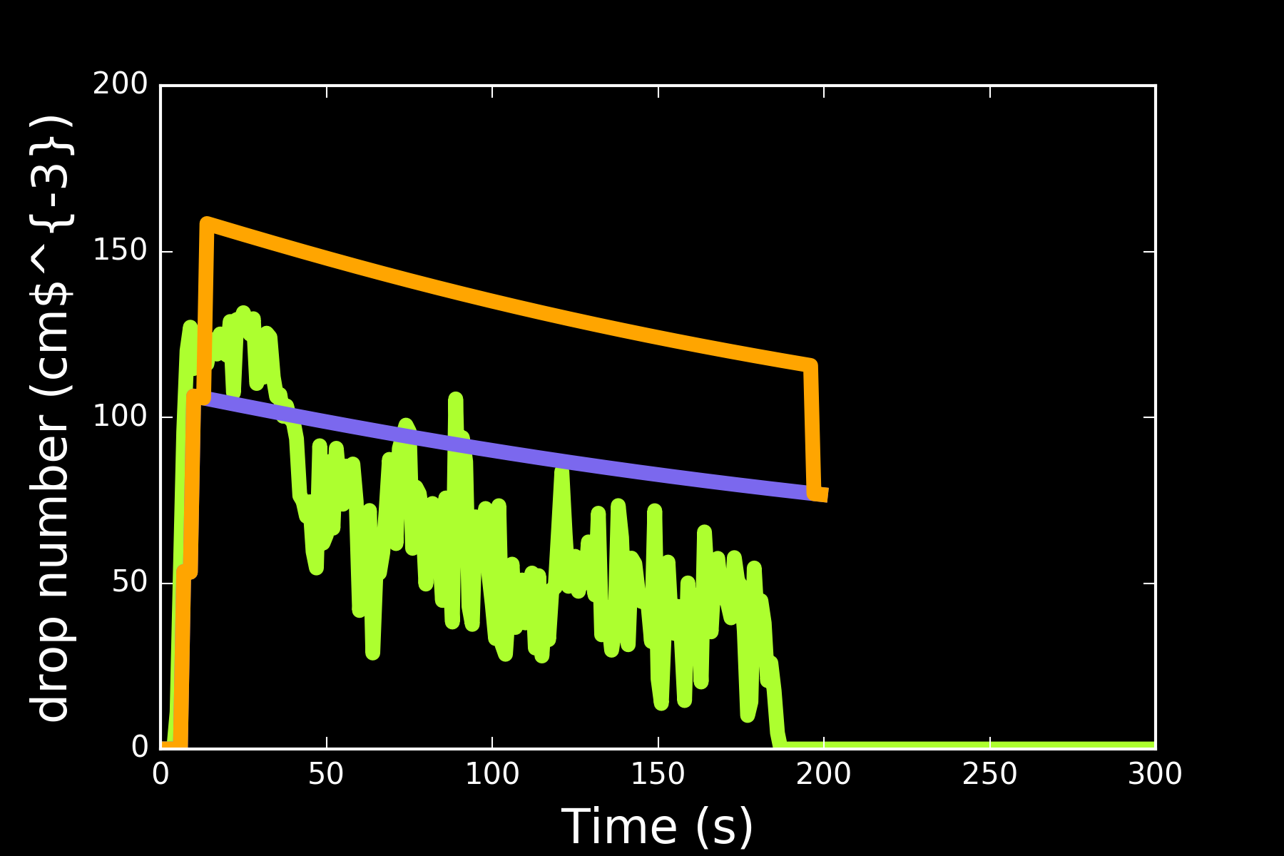
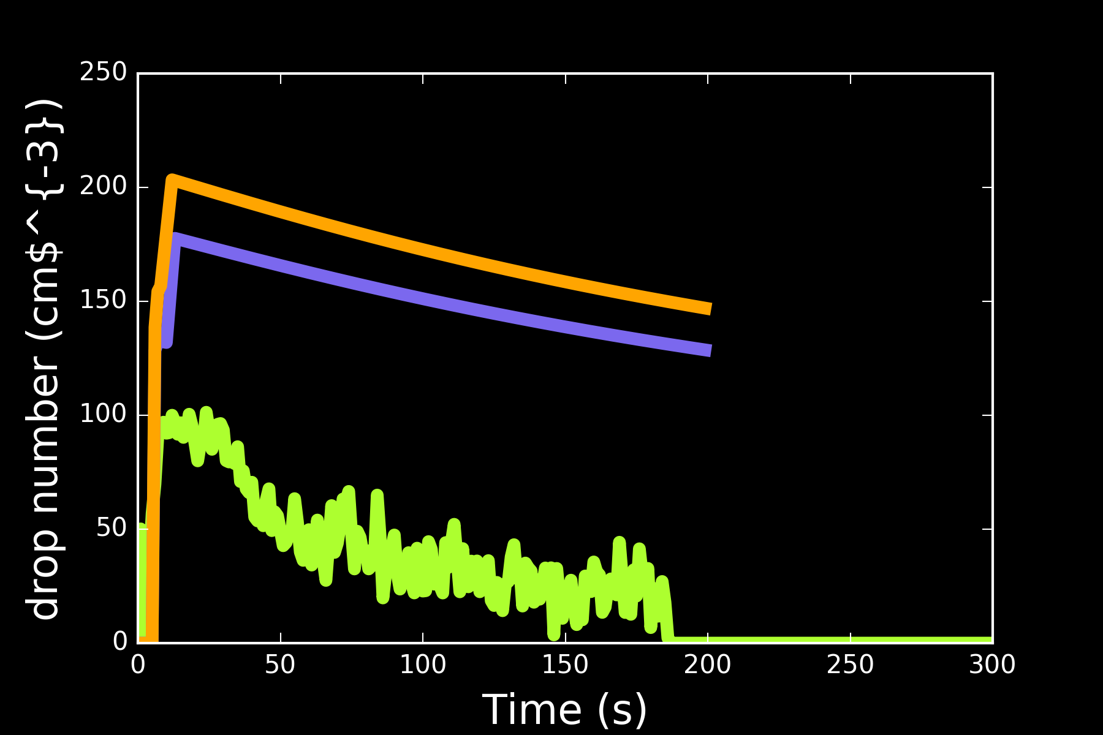
Chamber results - Glutaric acid

Slide 19
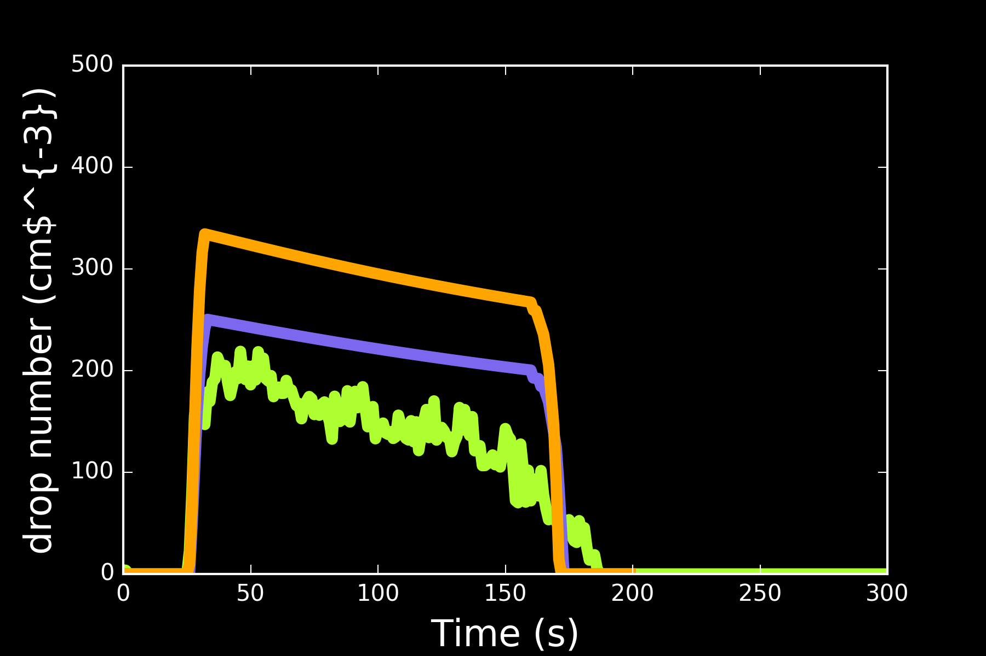
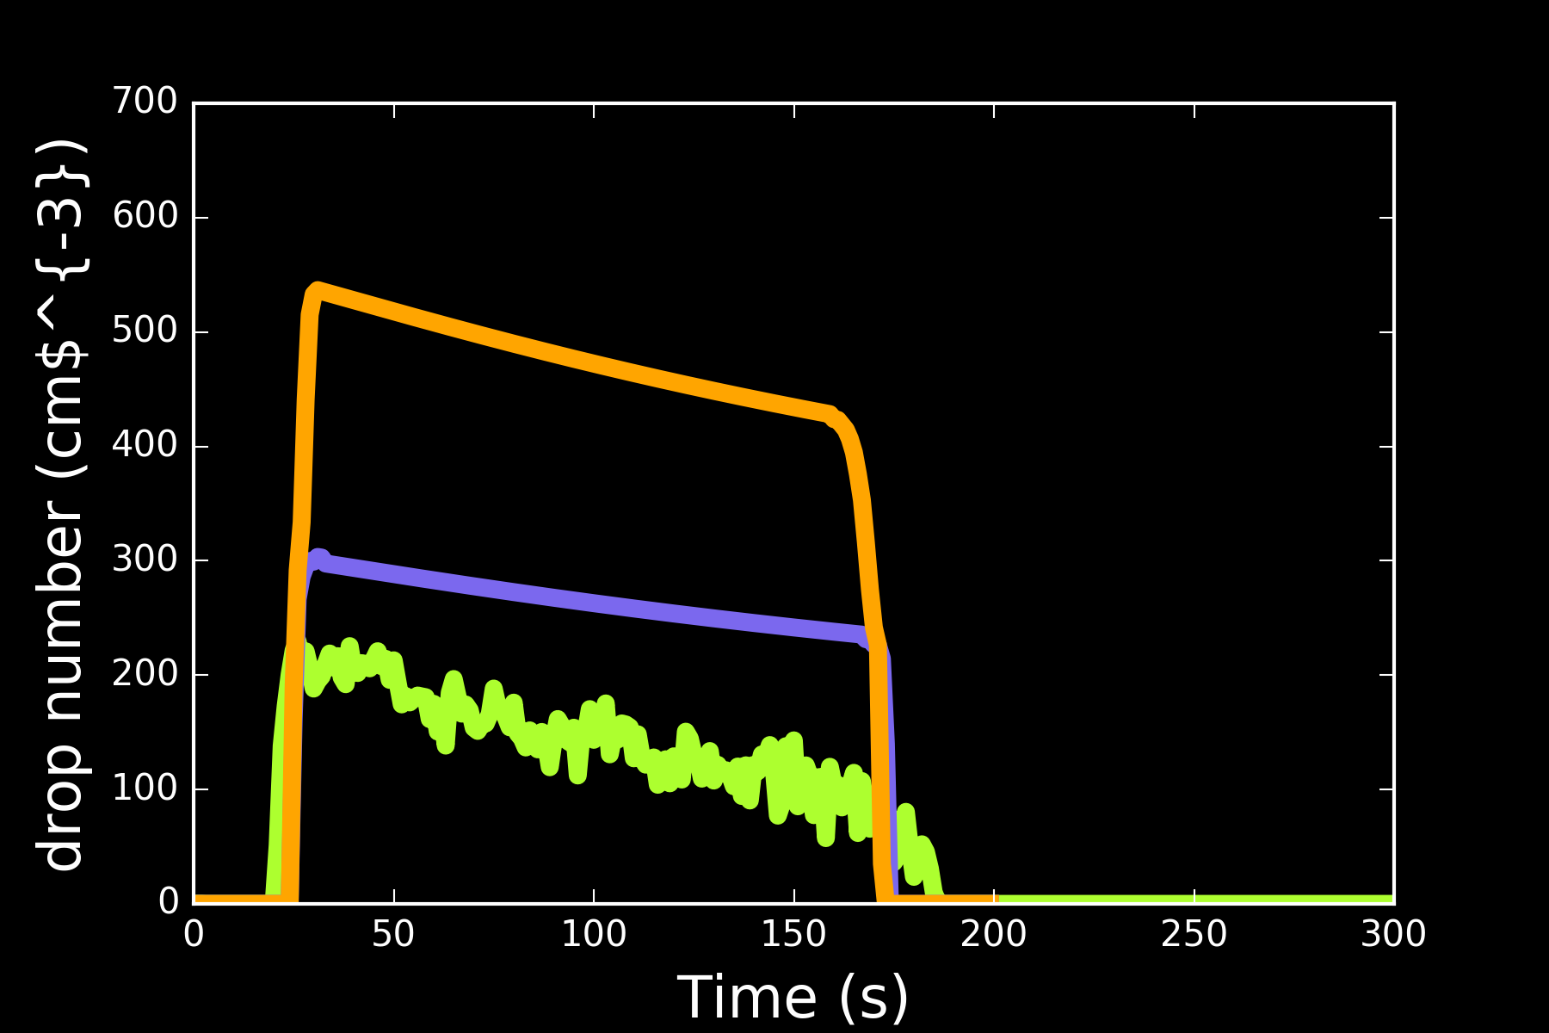
Chamber results - 1,1 cyclobutane

Slide 20
Summary
pyACPIM - open access cloud parcel with user interface, download from github - https://github.com/emmasimp/py-cloud-parcel-model/releases
Model compares well observations of nonvolatile aerosol in cloud chamber experiments
Observed potential cloud processing of high volatile compounds
Further work - explore uncertainty in aerosol size distribution and partitioning between vapour and condensed phase for semi-volatiles

